Slide 1

Reclaim
Med-Fi Prototype

Slide 2



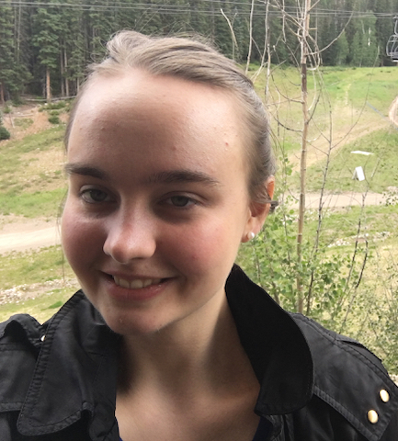
Our Team
IGOR B
MILES M
DISNEY V
MELISSA W

Slide 3

Problem-Solution Overview
PROBLEM
SOLUTION
As a buyer, finding a local seller who is willing to sell is hard
A reverse marketplace that unlocks hidden supply
Reduces burden on sellers to manually list items
* See speaker notes for full problem/solution overview
Notes:
As a buyer, finding someone in your community who’s selling what you need is hard—even if plenty of people would be willing to sell if asked. Reclaim is a reverse marketplace where buyers post what they need and anyone nearby can fulfill their request. Reclaim unlocks hidden supply for buyers and reduces the burden on sellers to manually list everything they’re willing to part with.

Slide 4


MISSION STATEMENT
MISSION STATEMENT
VALUE PROPOSITION
VALUE PROPOSITION
To make buying used easier than buying new
Everything is for sale

Slide 5
Tasks
Request an item (simple)
Post an offer to someone else’s request (medium)
Compare and respond to offers on one’s own request (medium; unified with task #1)
Set up automatic alerts (renamed to watchlist) for items (complex)
We found these tasks worked well during our low-fi tests, so we made no changes (apart from renaming alerts to watchlist in our interface).

Slide 6
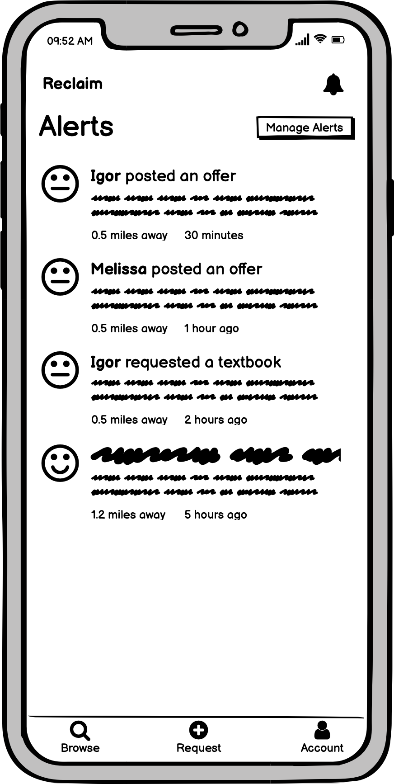
Problem: Alerts
Recap from our user testing
User had difficulty finding automatic alert functionality
Confusion between alerts and notifications
* See speaker notes for more details
Notes:
Our alert feature allows for users to be notified if someone requests an item they are looking to sell. Last week, our users had issues finding our automatic alerts features. They took a while to discover how to reach this feature - by clicking the bell icon and then the “Manage Alerts” button, highlighted in green. We found that our users thought of the bell icon as a read-only part of the interface and did not expect this icon to be associated with the ability to set up a new alert. Our users were also confused about the difference in meaning between “alert” and “notification”.

Slide 7
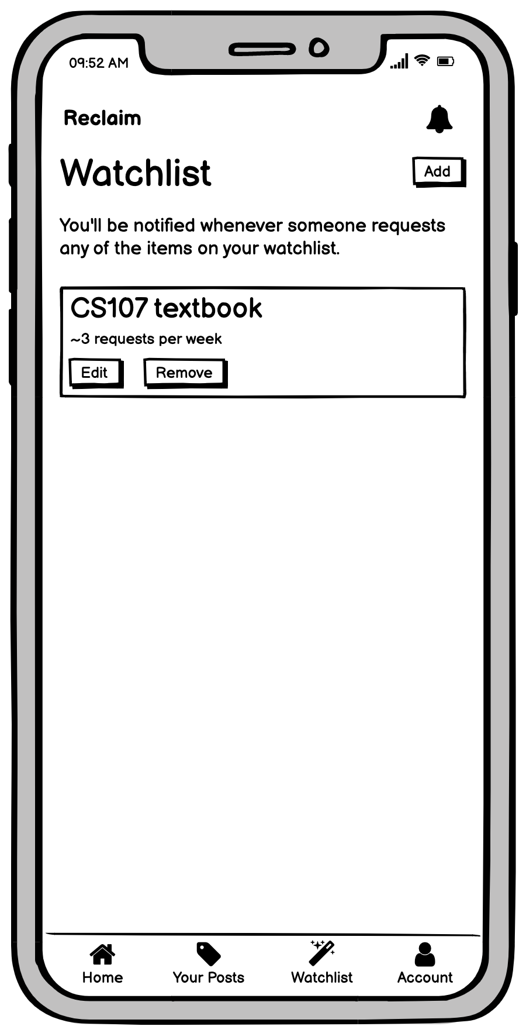
Solution: Watchlist
Reconfiguration of the alerts feature
Changed name “Alerts” to “Watchlist”
Added “Watchlist” button on bottom menu for easy access
Reduced number of clicks required to use this feature
* See speaker notes for more details
Notes:
We decided to reconfigure our alerts functionality. First, we changed the name of this feature from “alerts” to “watchlist” to eliminate confusion regarding the difference between an alert and a notification. We also placed a “Watchlist” button in the bottom menu, highlighted in green, to make it easier for our user to find this feature. This button includes the magic wand icon, which we hope illustrates that being notified when someone posts an item that you want to sell is so easy that it’s almost like magic. Introducing this button in the bottom menu also reduces the number of clicks required to use this feature, which we hope will make life easier for our users!

Slide 8
Alerts Redesign Comparison
* See speaker notes for more details
Notes:
Here is a comparison between our original and revised designs. The alerts feature was originally accessed through the bell icon and is now accessed through the “Watchlist” bottom menu button. You can also observe the associated button name and icon changes in the bottom menu.

Slide 9
Problem: Bottom Menu
Recap from our user testing
Users thought they could access their past requests using the +Request button
Users had trouble finding their requests and offers
No home button
* See speaker notes for more details
Notes:
We noticed some issues during our user testing relating to the bottom menu. For example, users thought they could access their past requests using the +Request bottom button, which is highlighted in green. However, we created this button only to help users create new requests. We also noticed users had difficulty finding their requests and offers, which were located in the account view menu. Finally, we learned that users may be confused by not having a home button, as is common in many apps.

Slide 10
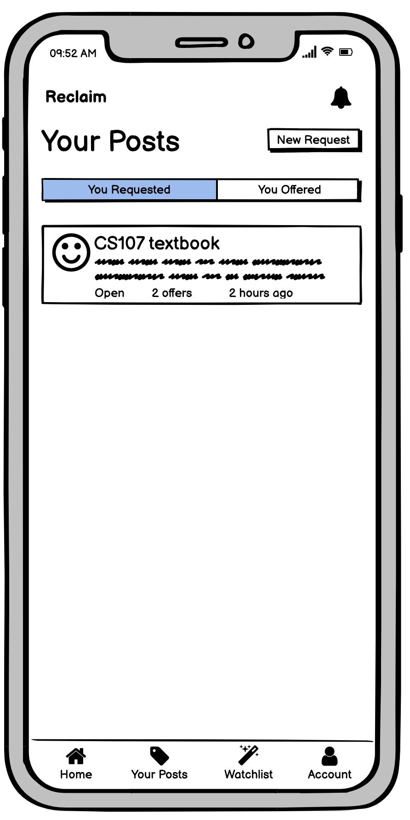
Solution: Redesigned Menu
Edits to 3 of the bottom buttons
Changed “Browse” button to home
Changed new request button to “Your Posts”
“Your Posts” now includes options to view what you have requested and offered
* See speaker notes for more details
Notes:
We decided to reconfigure our bottom menu. First, we changed the browse button to the home button to help our interface feel more familiar to the user, as suggested by Victoria. Second, we decided to remove the add request bottom button. We replaced it with the “Your Posts” button and accompanying tag icon, which is highlighted in green. Previously requests and offers were only accessible through the account menu, which was inconvenient and difficult to find. Our redesign makes these key features much more accessible to our user as “Your Posts” allows users to easily view the posts that they requested and the posts where they made an offer. It also includes the “New Request” button at the upper right hand corner. We believe that this design is much more intuitive for our user and hope that it will help them navigate our app with ease!

Slide 11
Bottom Menu Redesign Comparison
* See speaker notes for more details
Notes:
Here is a comparison between our original and revised designs. You can see here how the “New Request” button (highlighted in green ovals on both screens) remains easy to access and can observe how our new design makes your requests and offers (highlighted in a green box) just as easy to find! Additionally you can observe the other changes in the bottom menu that were previously discussed.

Slide 12
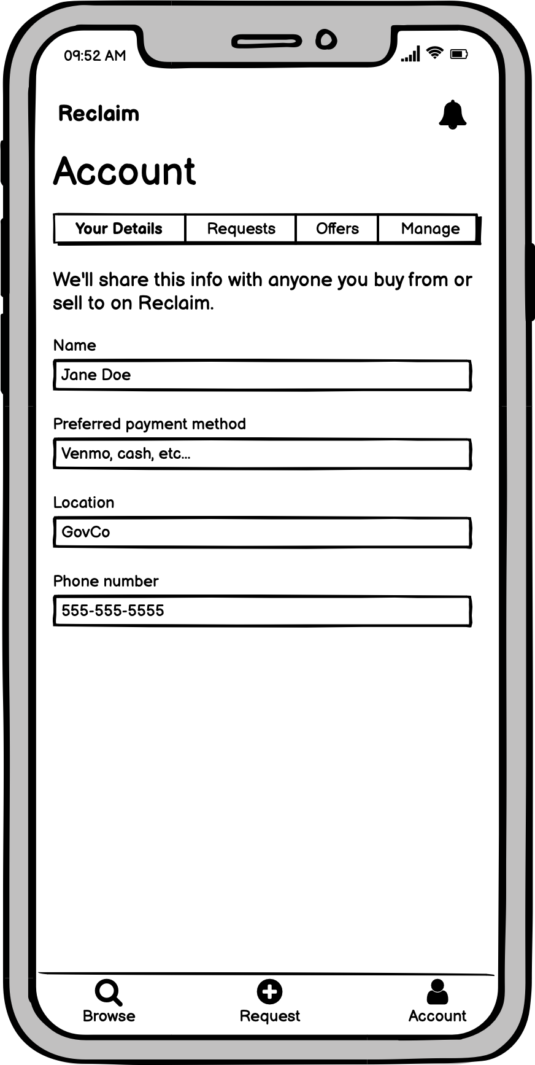
Problem: Account View
Recap from our user testing
Menu included key functions that were difficult to reach
Confusion between “Your Details” and “Manage”
Uncertainty about privacy of user information
* See speaker notes for more details
Notes:
Our original account view included an upper menu, highlighted in green, which provided some key features. We realized that the “Requests” and “Offers” buttons in this menu were difficult for our user to find since they can only be reached through the account view. We also learned from Victoria that the difference between “Your Details” and “Manage” may be unclear to the user. Finally, we realized that we did not adequately categorize privacy of the user’s personal data on this screen. For example, location and name on our app are shared with everyone, not just those who you buy/sell from.

Slide 13
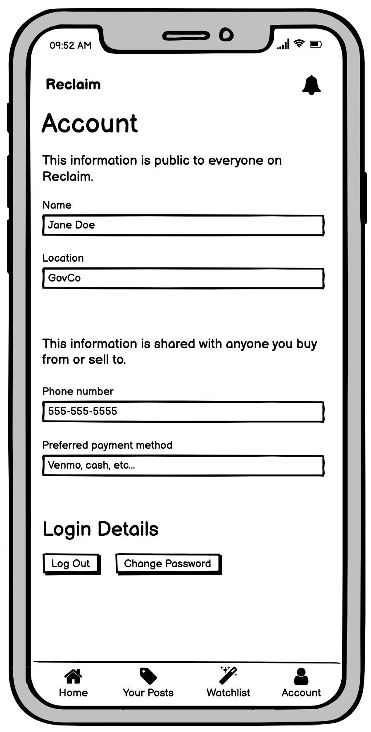
Solution: New Account View
Simplifying and clarifying
Merged “Your Details” and “Manage” buttons
This enabled us to remove the top menu
Clarified sharing of user data
* See speaker notes for more details
Notes:
We started our redesign of the account view by merging the two account-related buttons on the original account view upper menu, “Your Details” and “Manage”. We learned from Victoria that it might be difficult for our user to discern the difference between these two account- related buttons. As such, we merged them into one unified account view. As previously discussed, we removed the other two buttons on the original account menu -- “Requests” and “Offers” -- so merging the last two buttons on this menu allowed us to completely remove the top menu from the account page, as Victoria suggested. We also sorted and labeled the user’s information under two categories, highlighted in green, which state explicitly what information is public on Reclaim and what information is only shared during transactions. We hope our transparency regarding who our user data is shared with helps our users to feel more comfortable using our app. We also hope that this simplified interface allows our user to navigate without getting lost or having to search for key features!

Slide 14
Account Redesign Comparison
* See speaker notes for more details
Notes:
Here is a comparison between our original and revised designs. On the original account view, you can see how the upper menu (highlighted in green) was removed. On the revised account view, you can see how our account view provides clarification regarding personal data sharing, which is highlighted in green.

Slide 15
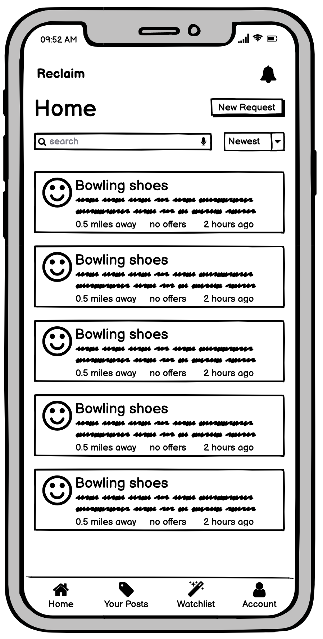
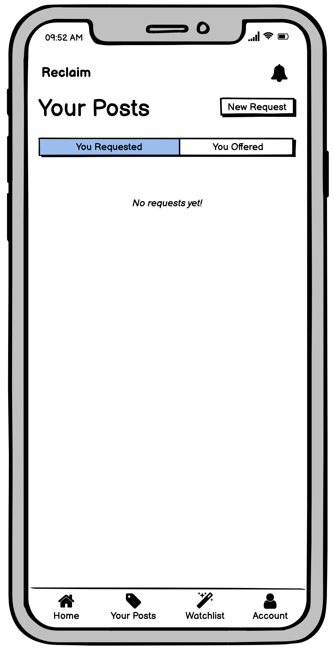
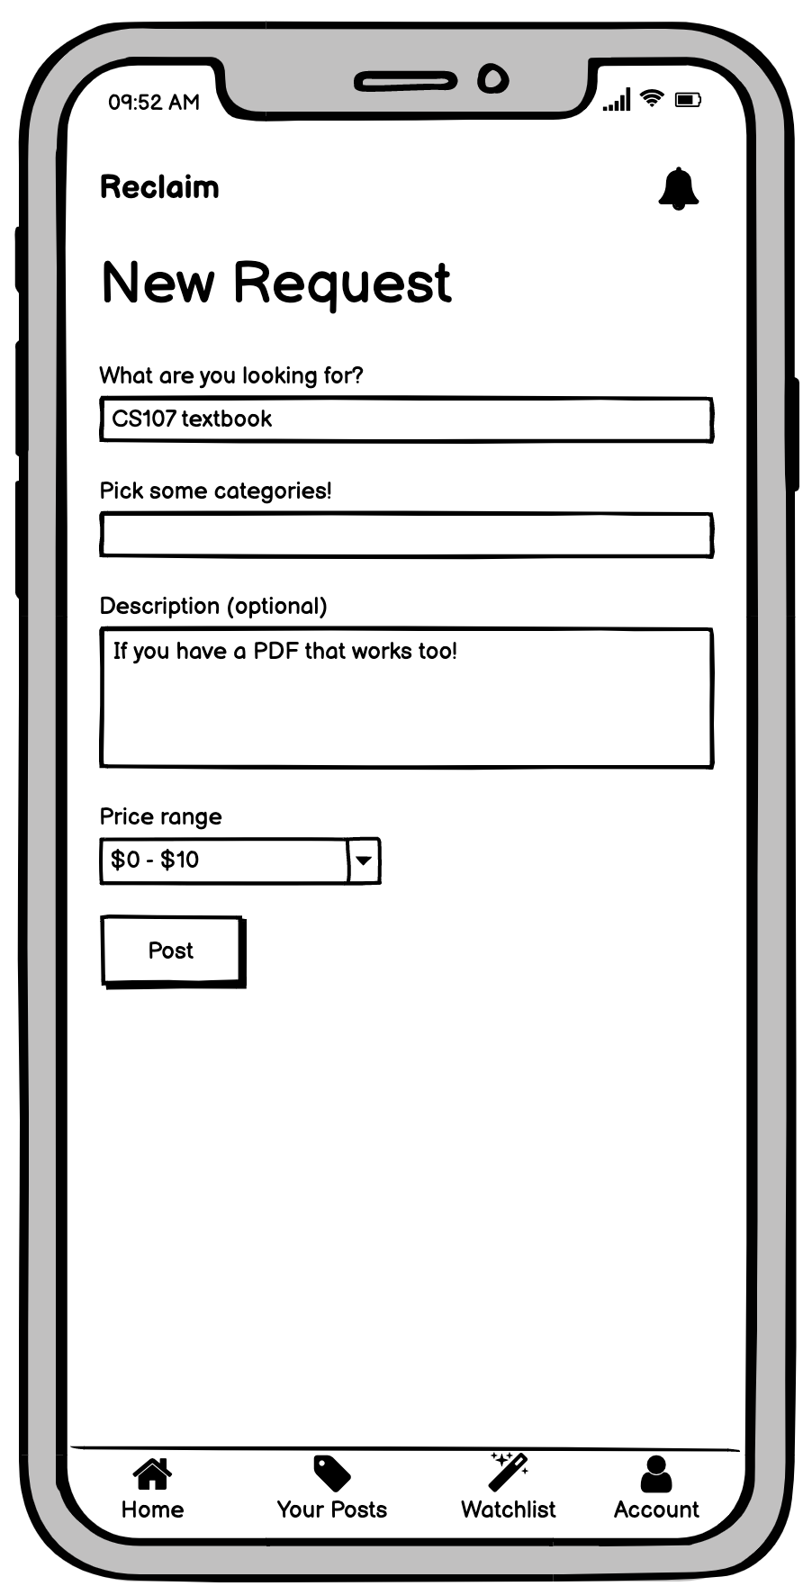
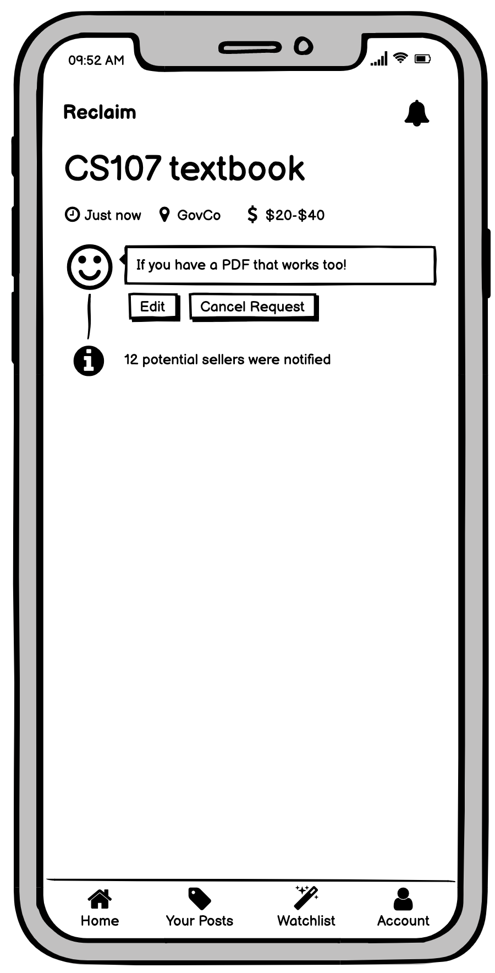
TASK 1: REQUEST AN ITEM
Option #1 to reach “New Request” Button
Option #2 to reach “New Request” Button
* See speaker notes for more details
Notes:
The path the user takes to complete this task is likely dependent on which screen they are on when they start the task. If they start on the home screen, they will likely tap the “New Request” button at the upper right hand corner of the home screen. However, it is also possible to click a “New Request” button on the “Your Posts” view. This option may be more likely to be chosen if the user starts on a screen other than Home -- for example, if they start on the account screen, as shown.

Slide 16
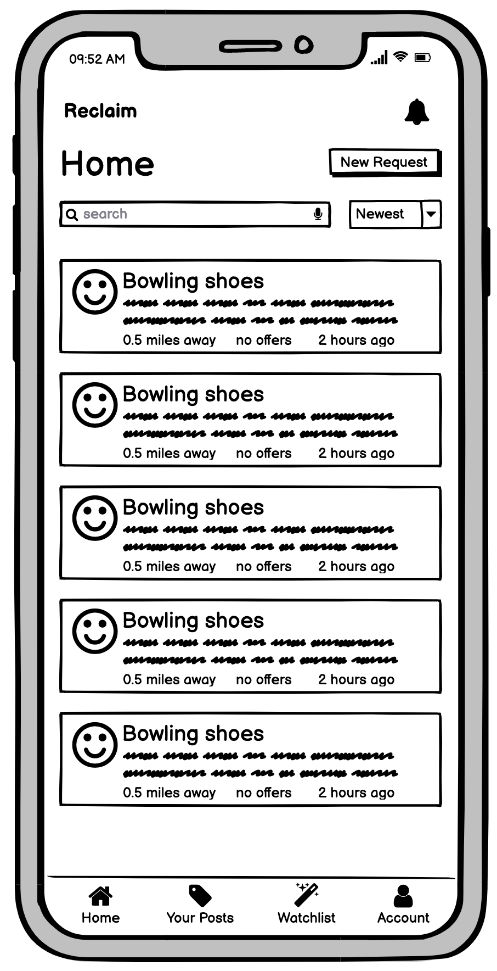
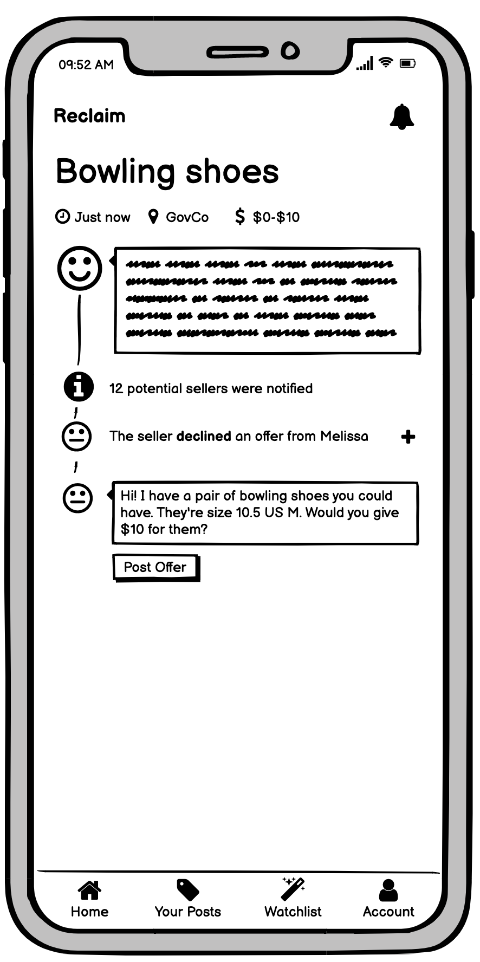
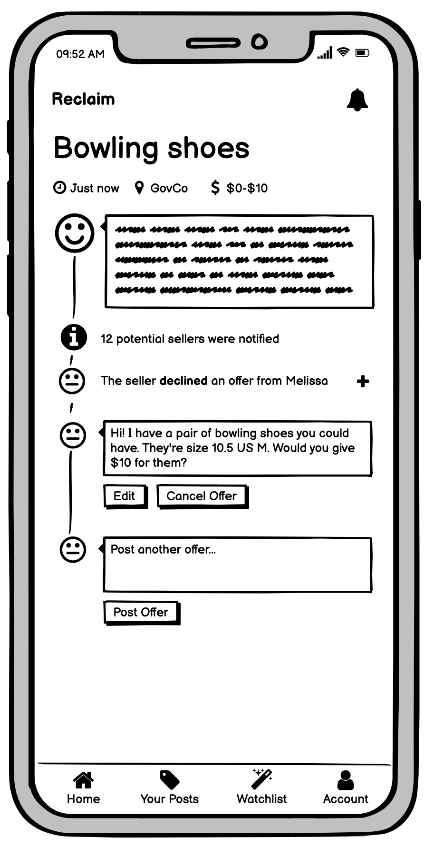
TASK 2: MAKE AN OFFER

Slide 17
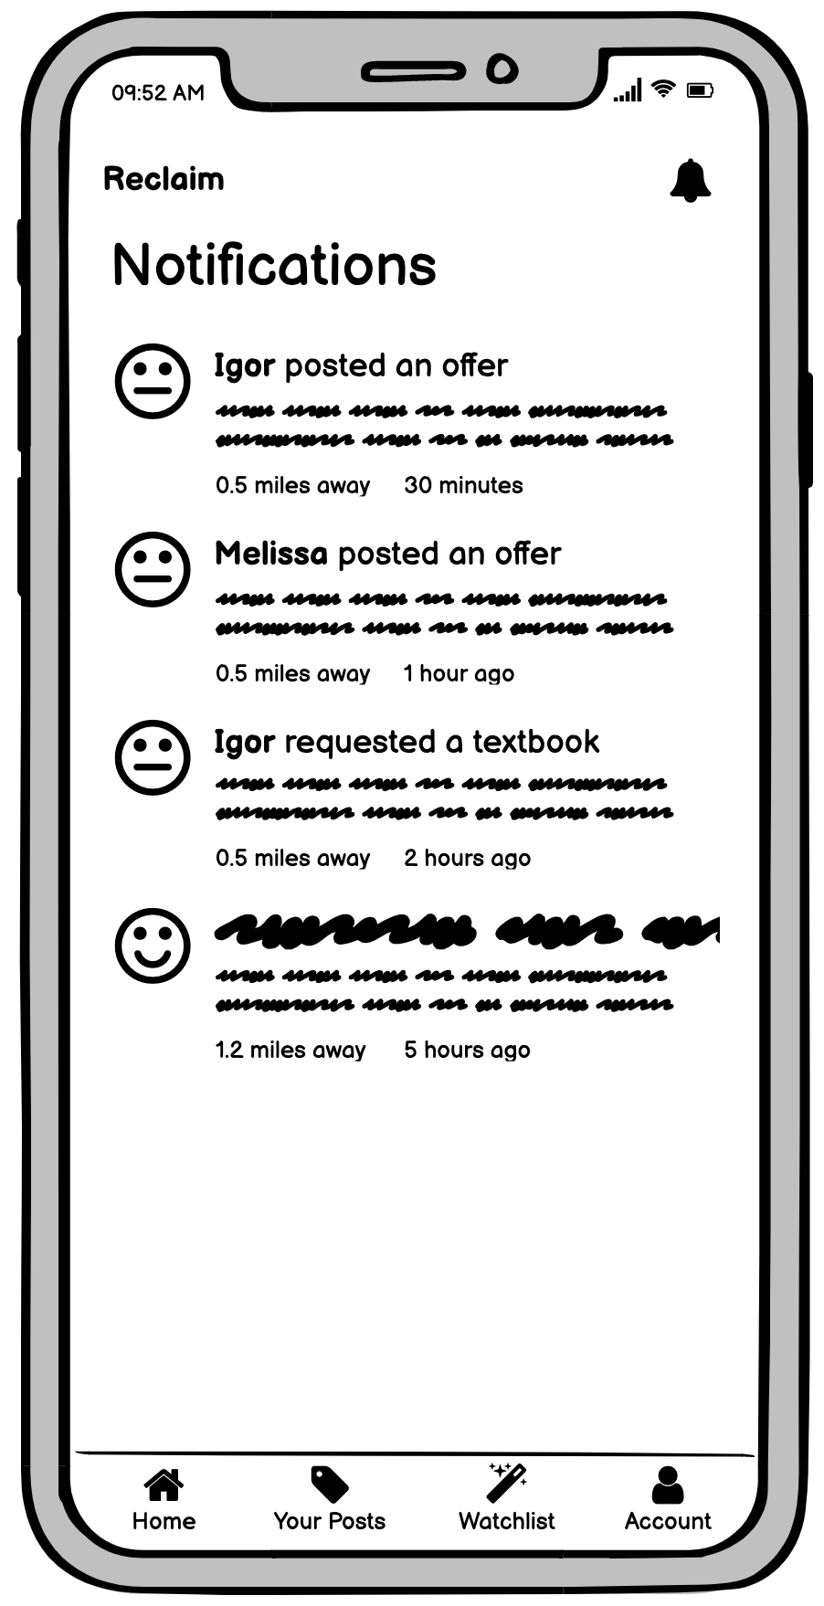
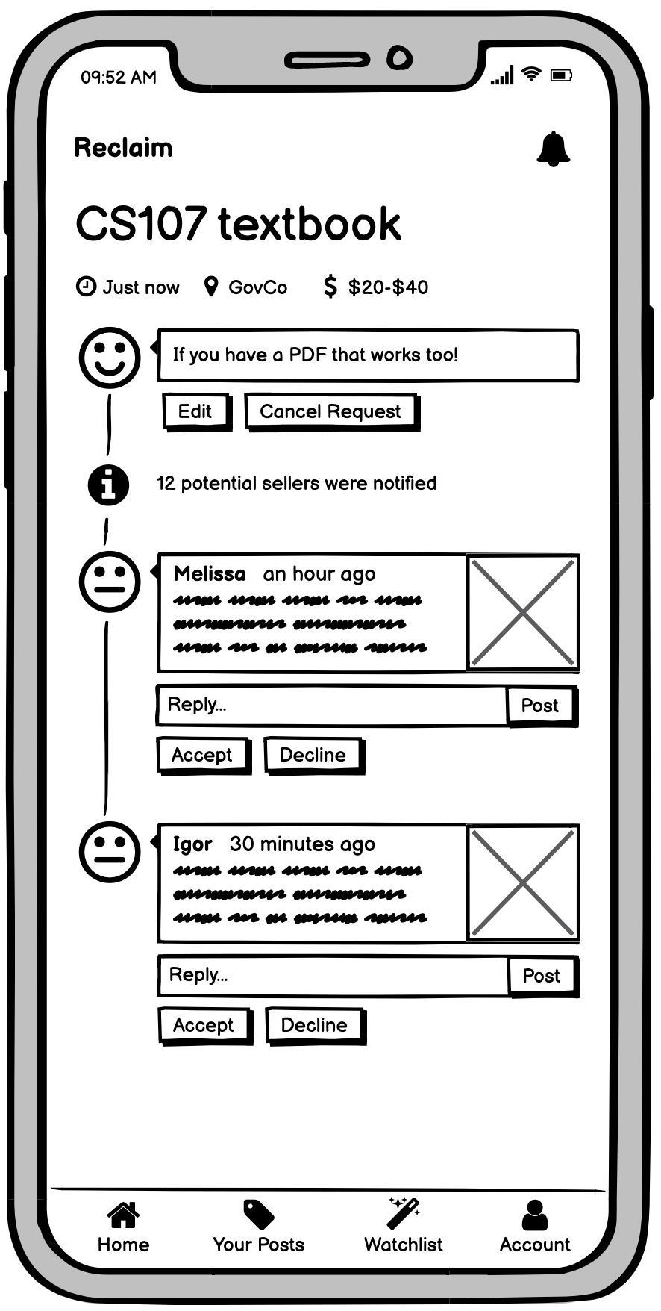
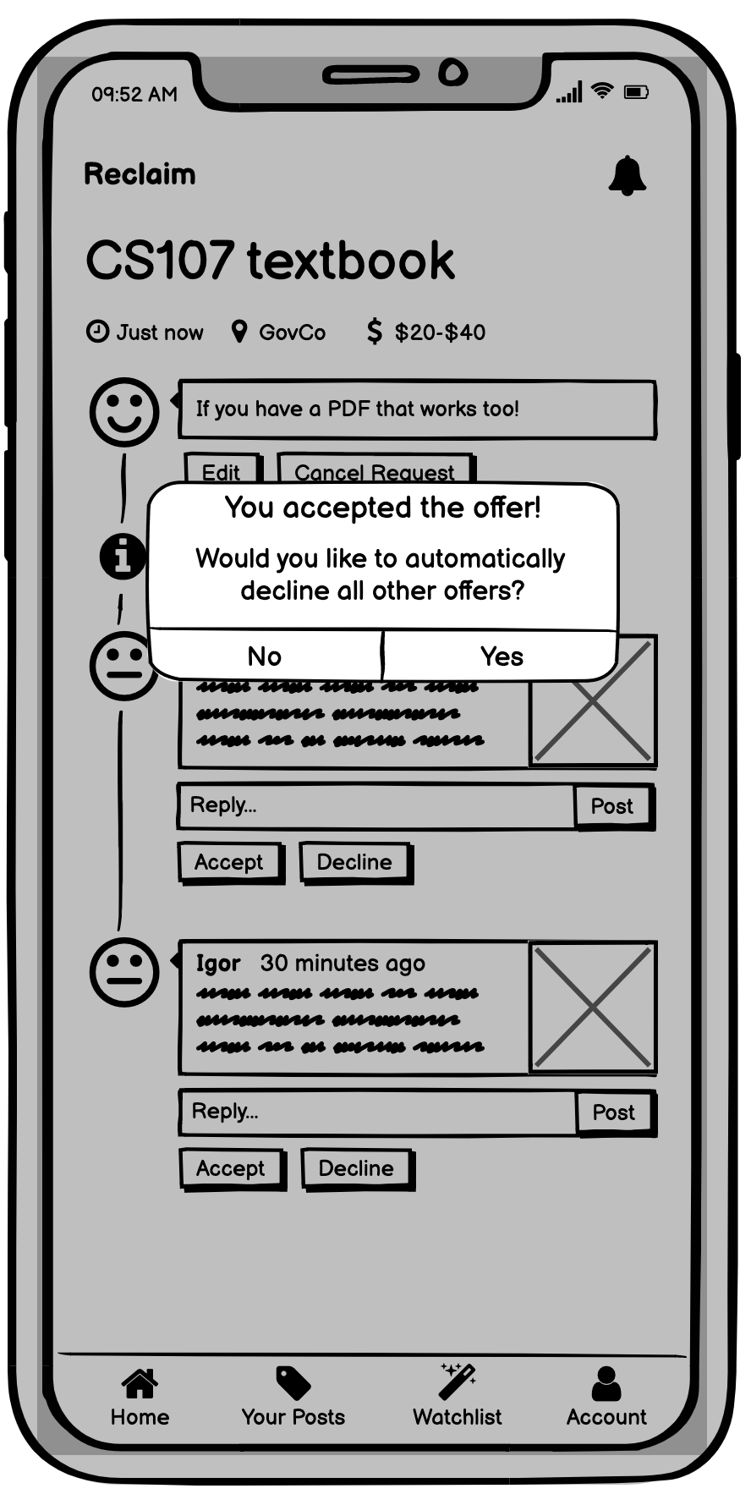
TASK 3: ACCEPT AN OFFER
Two ways to reach offer
* See speaker notes for more details
Notes:
You can reach an offer by tapping on an offer-related notification or by viewing your request posts to check them for offers.

Slide 18
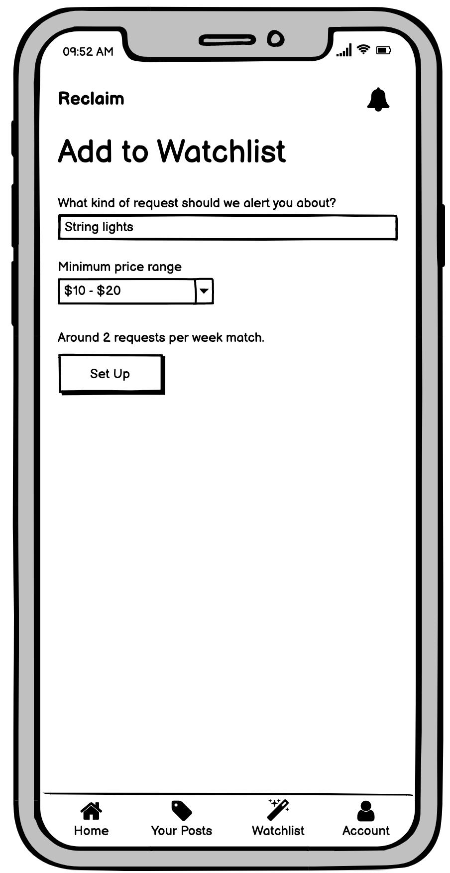
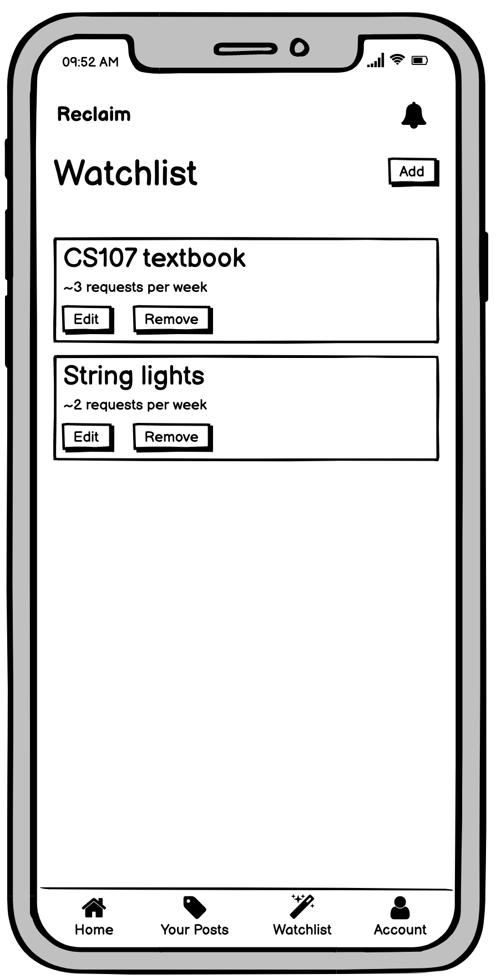
TASK 4: ADD AN ITEM TO WATCHLIST
TASK 4: SET UP AUTOMATIC ALERT

Slide 19
Prototype Tool: Figma
We built our prototype in Figma using the Iconify plugin with Fluent UI icons.
Easy
Simple to design basic views, icons, and components
Working collaboratively and simultaneously was wonderful
Doing both visual design and prototyping in the same tool was very convenient
Autolayout was extremely helpful for dynamic, feed-like views
Hard
Even though we used components extensively, updating core elements of storyboards was difficult (had to manually update each screen)
Identifying small inconsistencies across different frames was challenging

Slide 20
Limitations and Tradeoffs
The notifications view is not dynamic
In most of our tasks, other ‘users’ are interacting with the main user
These interactions are not reflected in our prototyped notification view, as it is too state-dependent
Our final task—adding an item to your watchlist—has no ‘follow-up’
The user can only add the task to their watchlist; we don’t ‘Wizard of Oz’ someone requesting that item later
We do, however, include an example notification of an item on the user’s watchlist being requested
We do not include any editing functions
In most cases, edit view will be almost identical to the create view
Editing is very state-specific; hard to do in a static Figma prototype

Slide 21
Limitations and Tradeoffs, cont’d.
Only some buttons in the request view work.
Some buttons, like “Withdraw offer,” do nothing (though their function is clear).
We wanted to keep our user on a relatively linear path through our application.
Our account view is relatively static
You can tap to update your information, but you can’t actually save changes.
Allowing changes would require dynamic input, which Figma doesn’t support.
Searching and sorting is not implemented
Because searching and sorting would just yield a different arrangement of content in the same interface, we thought it wouldn’t add value to the prototype.

Slide 22
Limitations and Tradeoffs, cont’d.
The back button is not always fully functional.
In certain flows, the ‘back’ button takes you to the previous point in time, not the previous view. It could also take you further back than you think. This is a consequence of Figma’s ‘back’ implementation, which does not always align with the structure of our prototype. Our high-fidelity prototype will not operate this way.
In interactive views, the fields can only be filled out in a single order.
In our actual prototype, you will be able to fill out the fields in any order.
We did not implement ‘collapsing’ offers.
We realized in this prototype that this functionality is only necessary for extremely long request pages, and could perhaps be better solved by just intelligently sorting the offers. Therefore, we did not include offer collapsing in our prototype (and are considering not including it in our final prototype).

Slide 23
Wizard of Oz Techniques
At steps in tasks where other users’ actions are required (e.g., posting an offer to the main user’s request), we ‘fake’ the waiting period by transitioning to the next screen automatically after a delay.
We ‘magically’ update the relative times (e.g., ‘5 mins ago’) in the application on views that require the passing of time.
In input views, we autofill all content ‘automatically’; Figma does not support dynamic input.

Slide 24
Hard-Coded Features
All user-generated content in the app is hard-coded
Dynamic input is challenging, and Figma cannot keep track of state.
Many areas of the app require interaction with other users, but our prototype needs to be usable by only one person.
This hard-coded content includes: requests, offers, offer decisions, account settings, notifications, and watchlist items

Slide 25
Acknowledgements
Our icons are from Microsoft’s Fluent UI icon pack.
All profile images are from ThisPersonDoesNotExist.com (and are not real people), except for the photo of James Landay (which we took from Stanford’s website).
We used iOS Keyboards (Community) by Rojcyk for the iOS keyboard component.

Slide 26
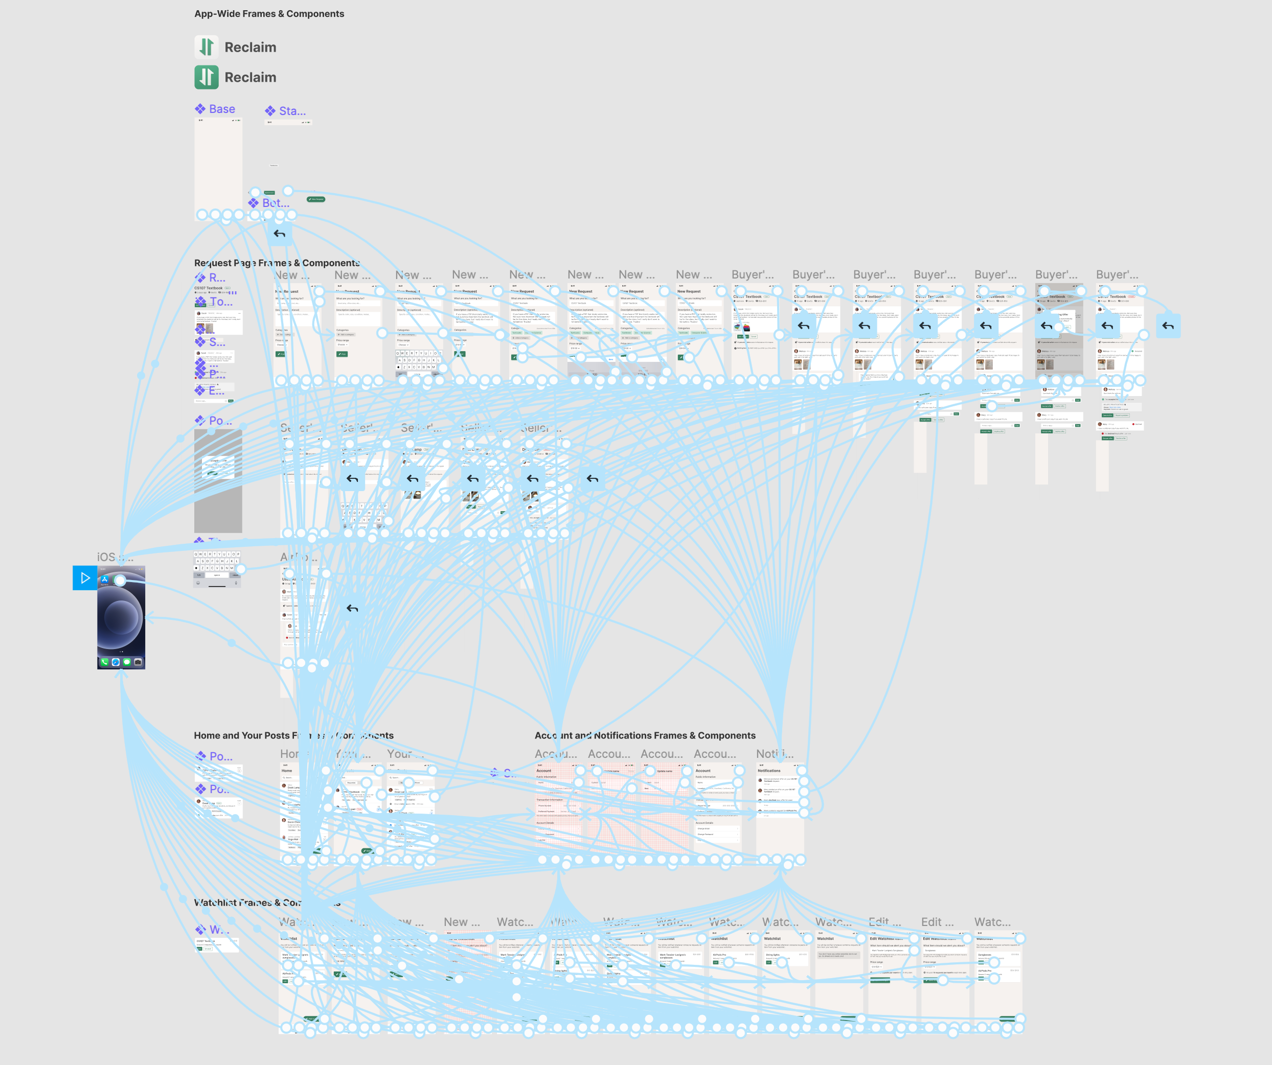
MED-FI OVERVIEW

Slide 27
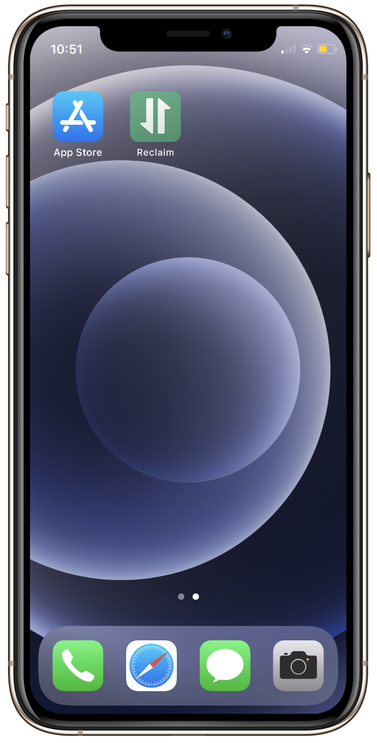
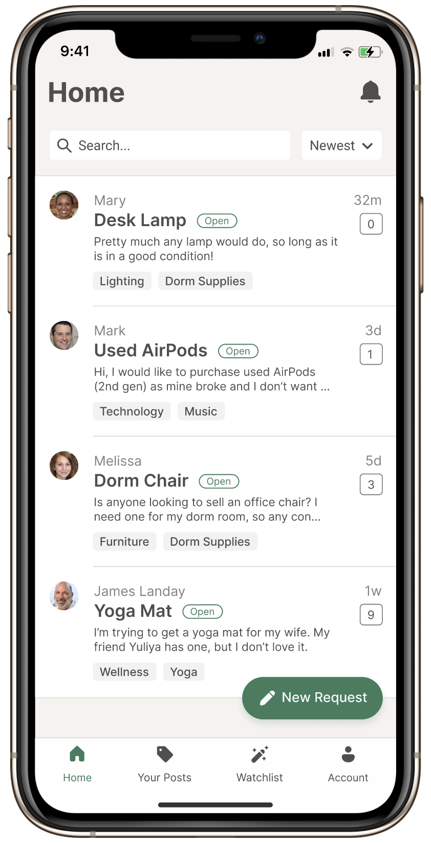
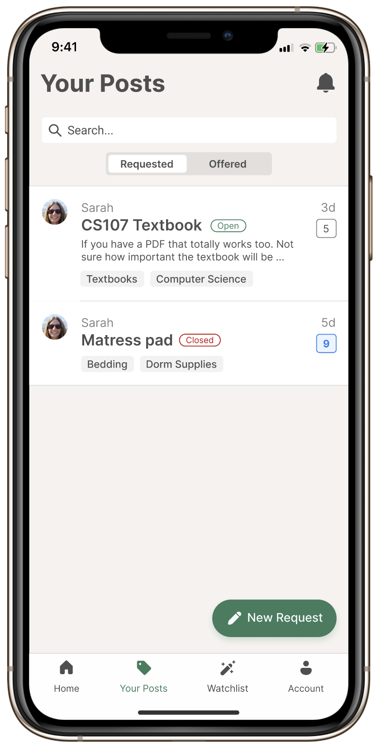
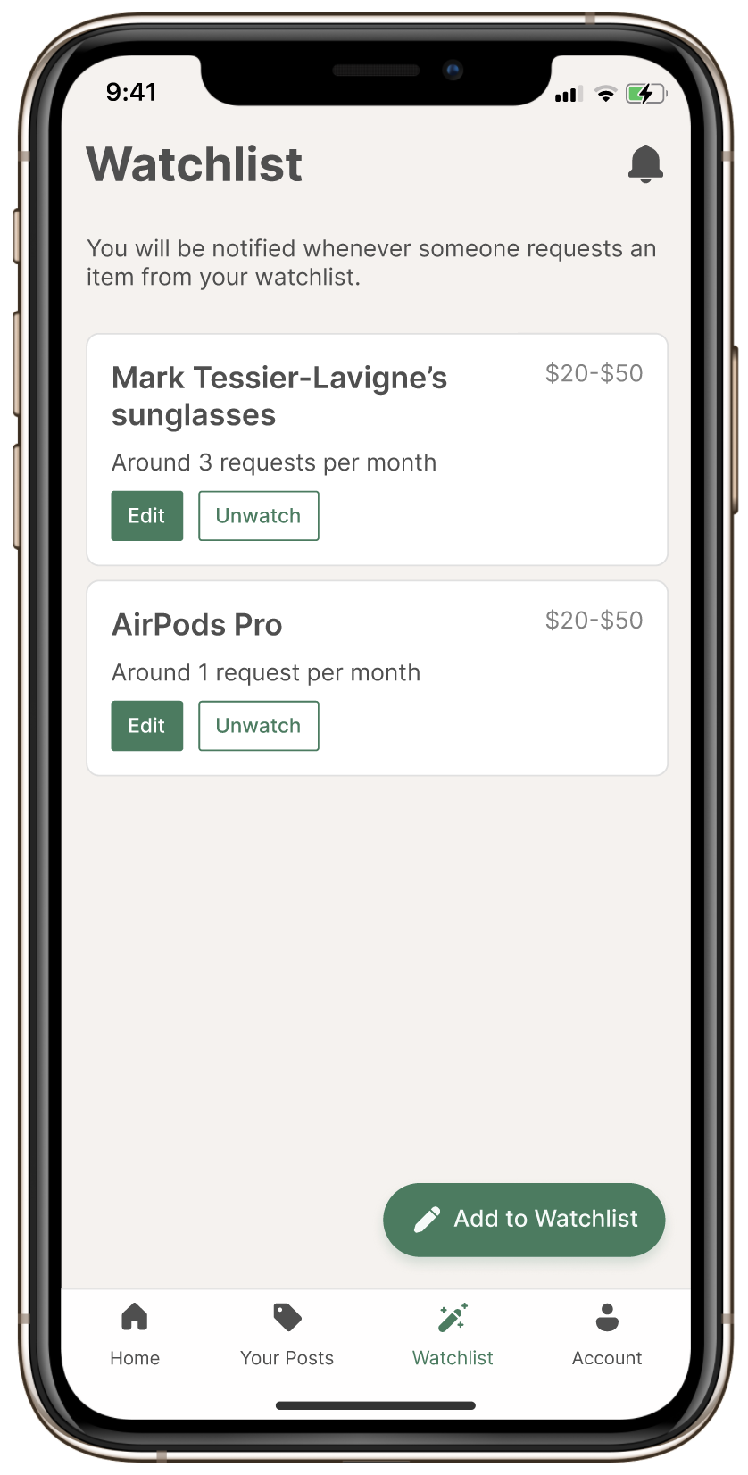
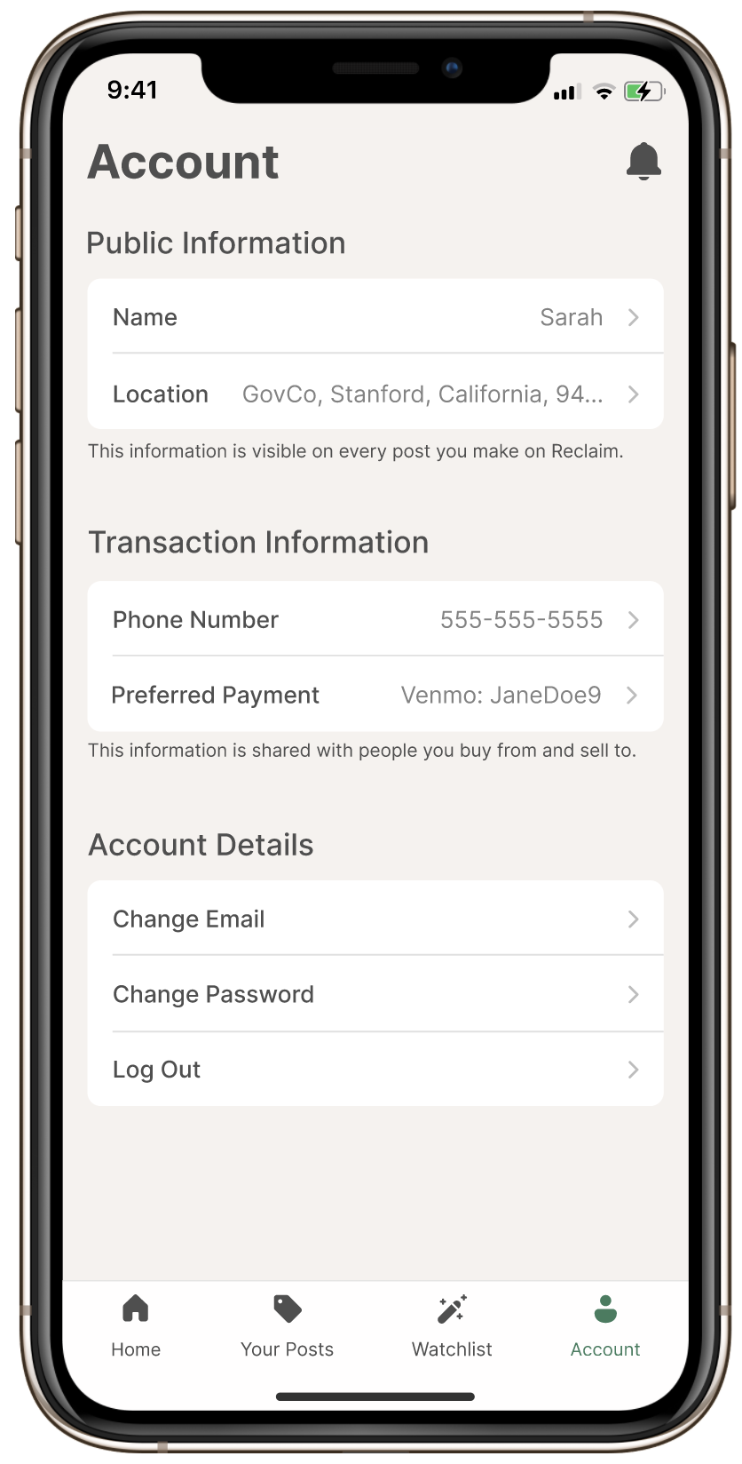
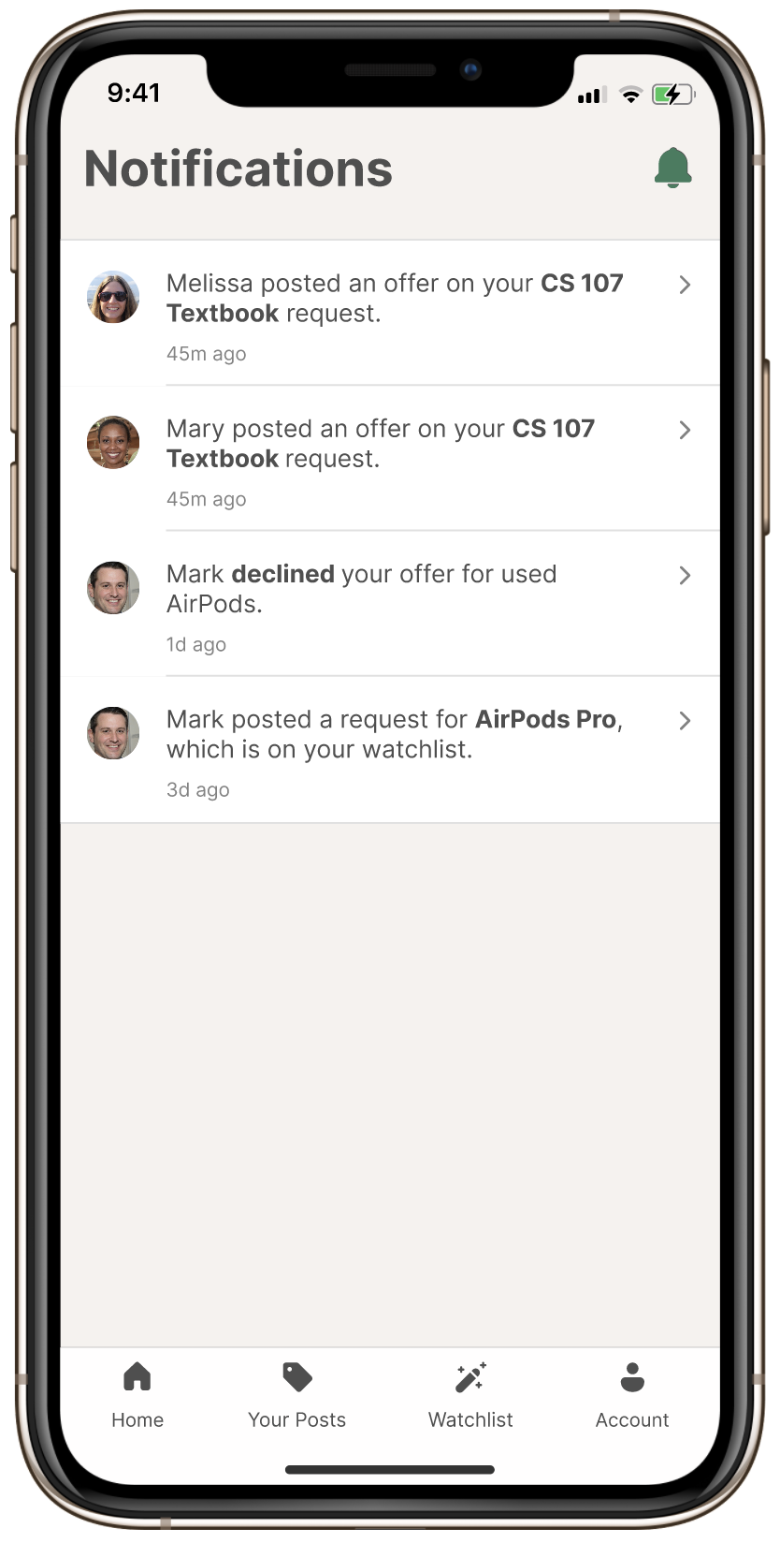
PROTOTYPE SCREENSHOTS
* Screenshots include the app icon, the four screens reached via the bottom menu, and the screen reached by the bell icon

Slide 28
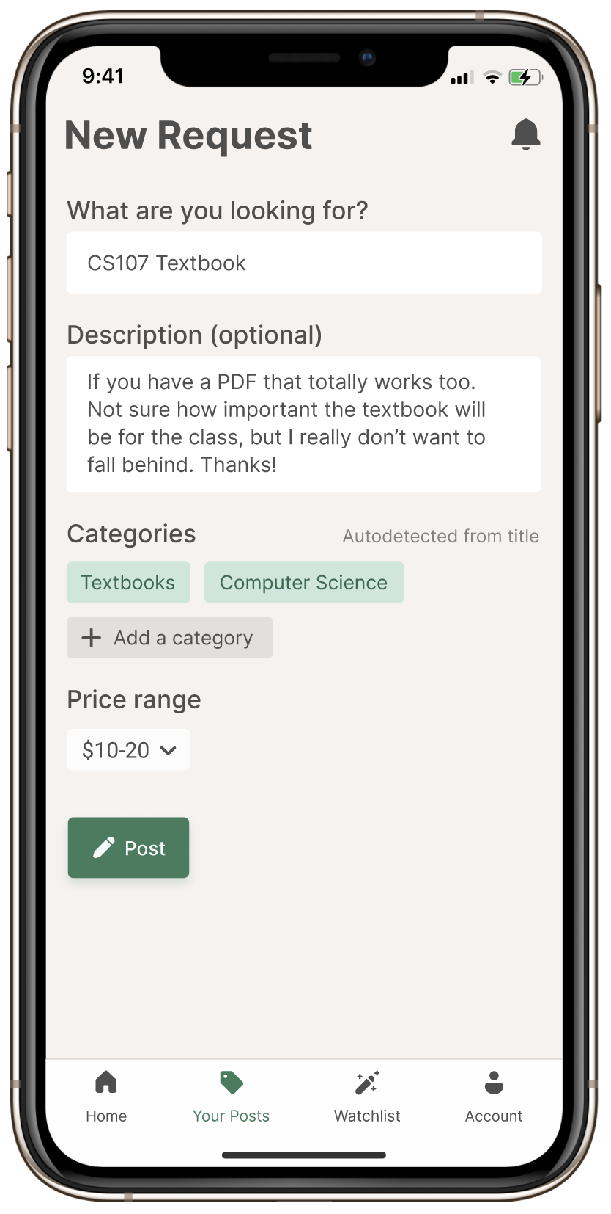
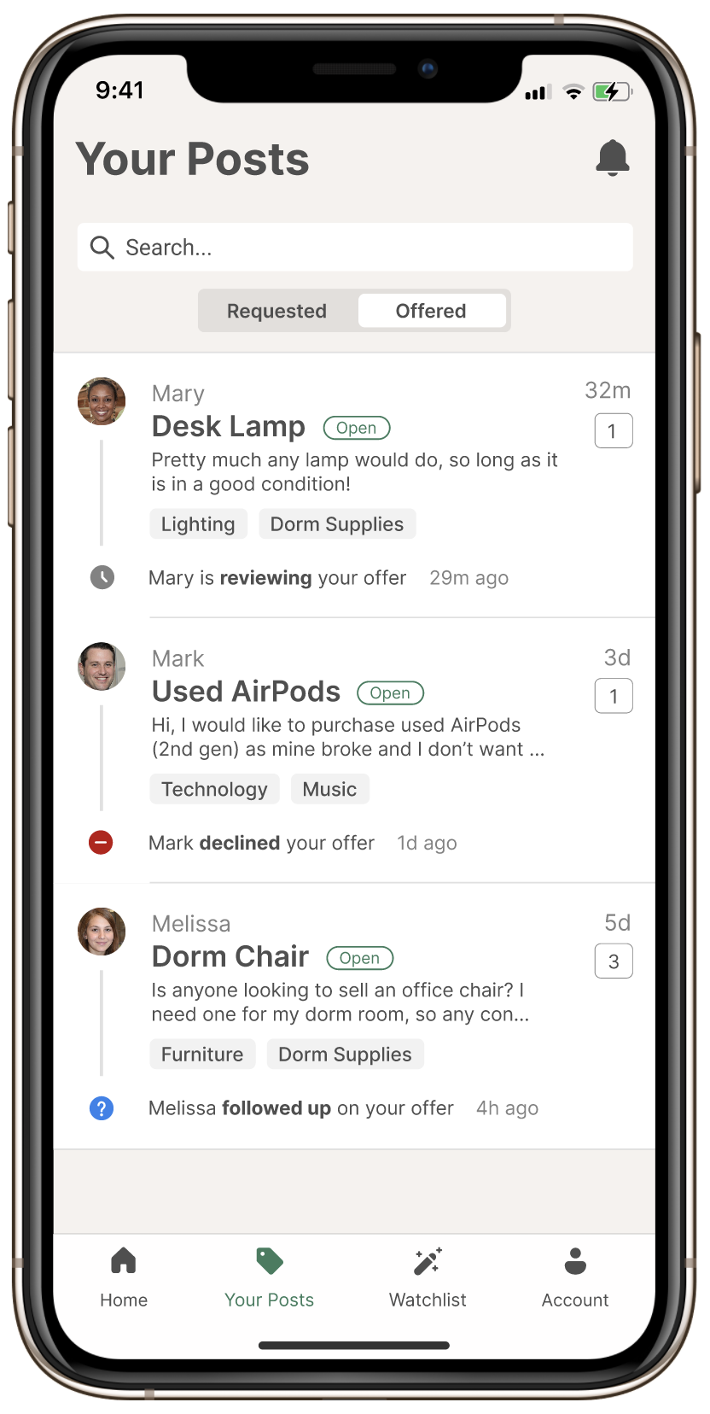
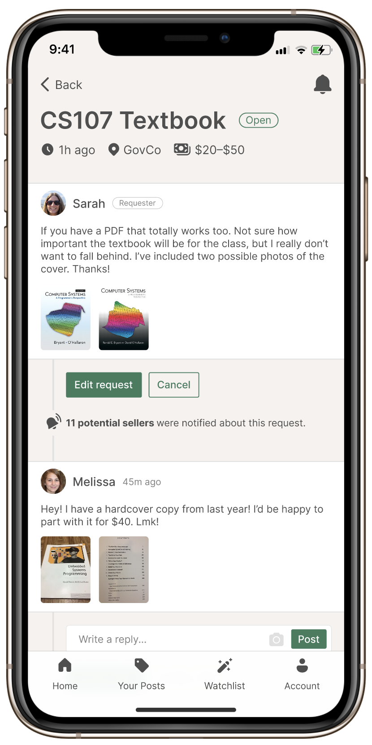
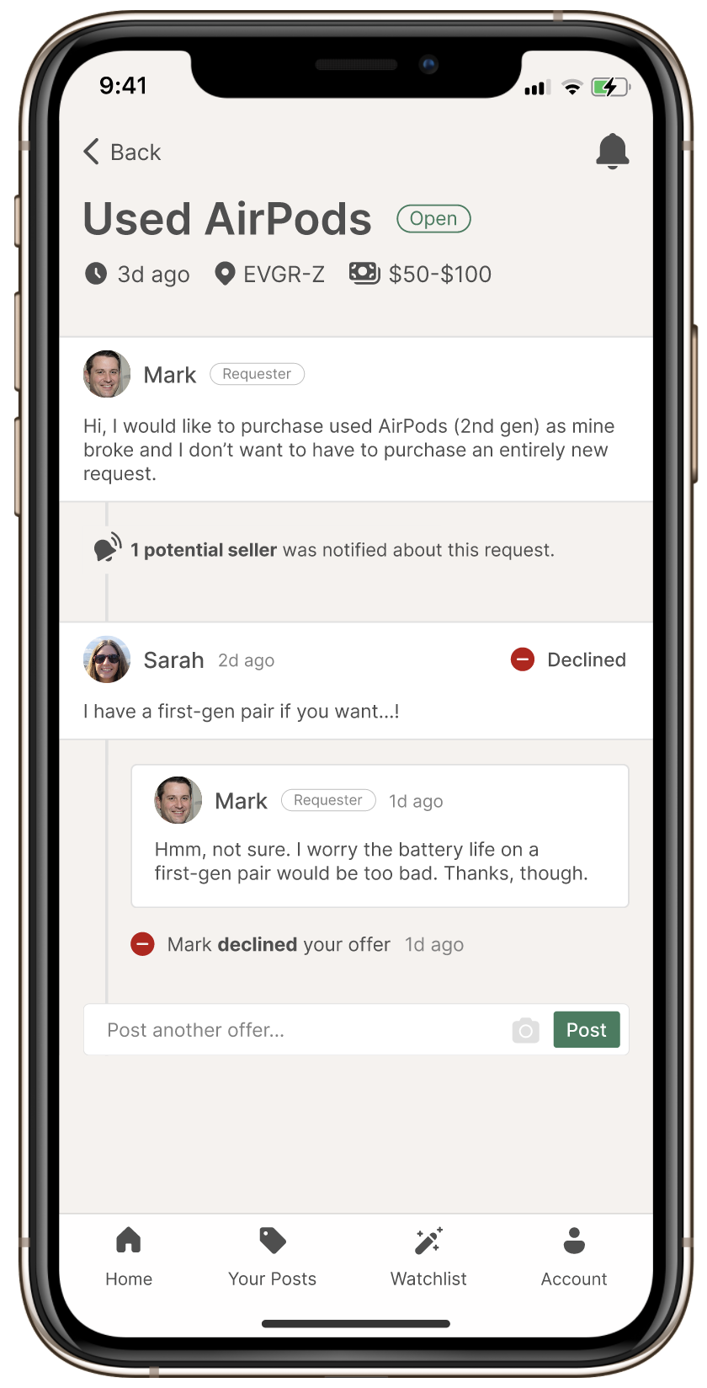
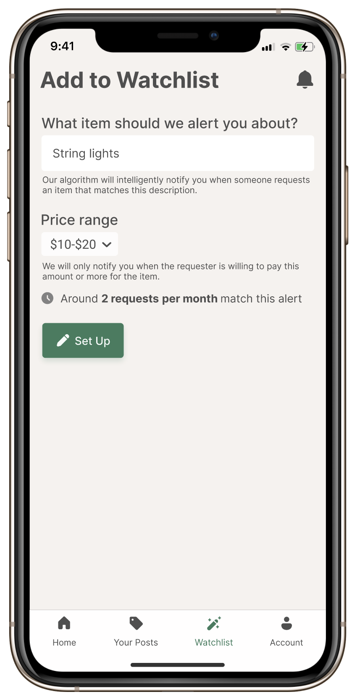
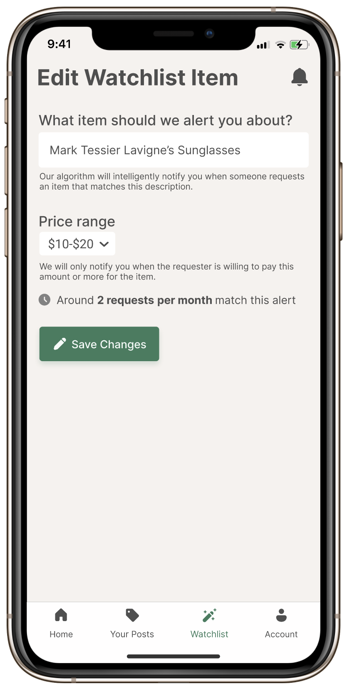
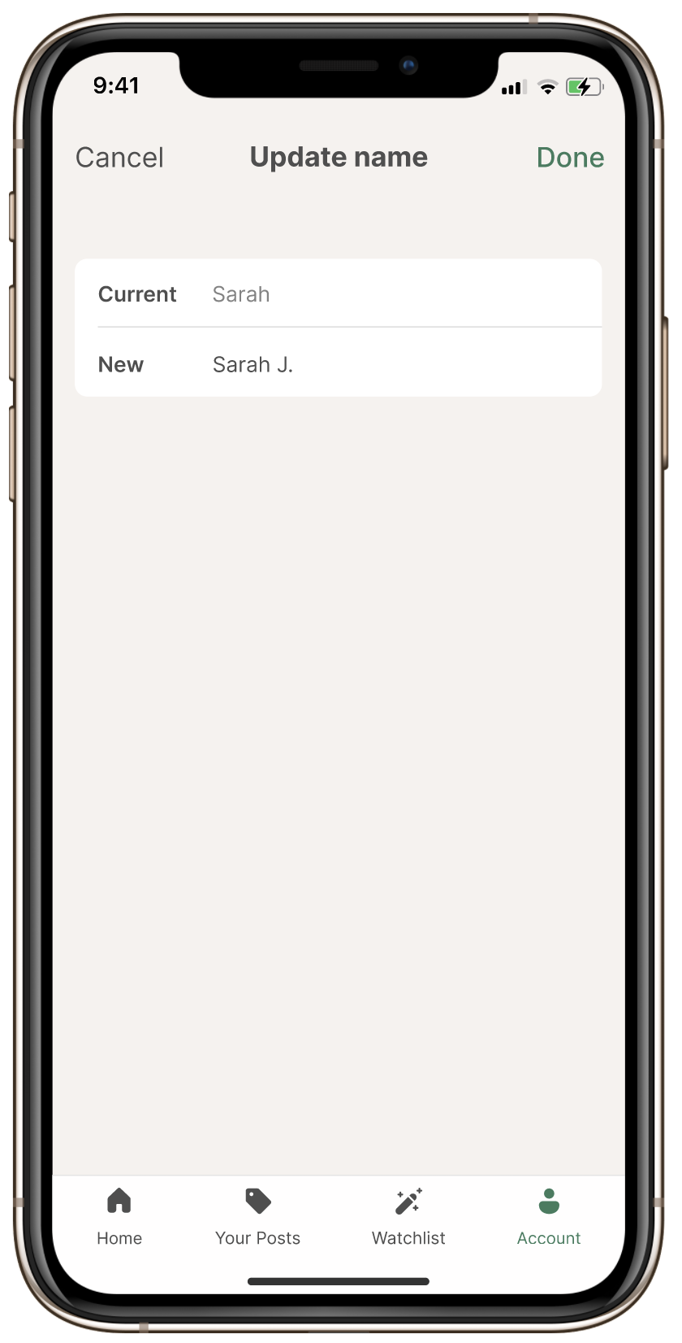
PROTOTYPE SCREENSHOTS
* Screenshots include potential screens for functionality related to adding a request, “Your Posts”, “Watchlist”, and updating account information

Slide 29
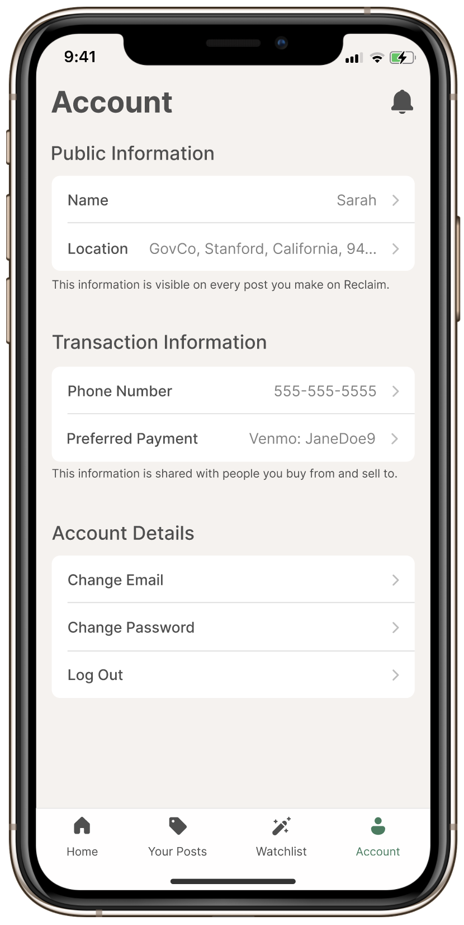
TASK 1: REQUEST AN ITEM, PART 1
Option #1 to reach “New Request” Button
Option #2 to reach “New Request” Button
* See speaker notes for more details
Notes:
The path the user takes to complete this task is likely dependent on which screen they are on when they start the task. If they launch the app, they will land on the home screen and may click the “New Request” button on this screen, which is highlighted in green. However, if the user starts this task on another screen, such as on the account screen (as shown in option 2), they may be more likely to navigate to the “Your Posts” screen and click the “New Request” button found on that screen, which is also highlighted in green.

Slide 30
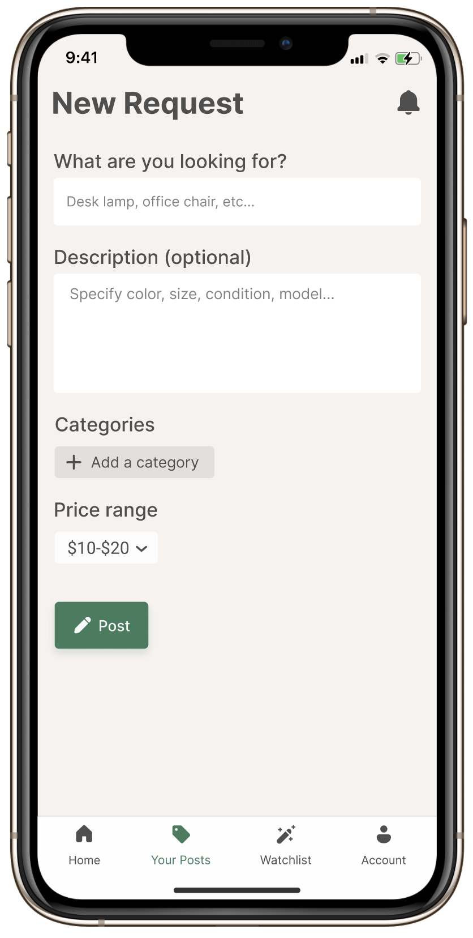
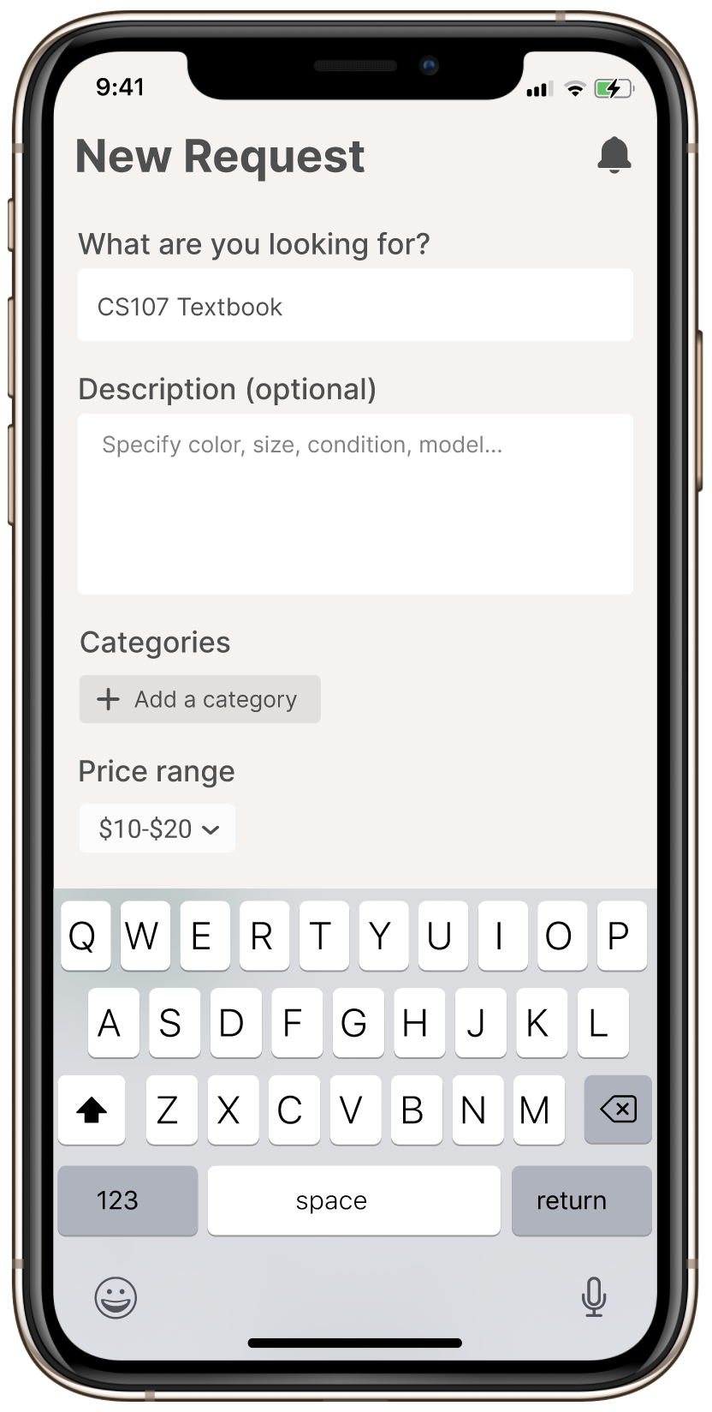
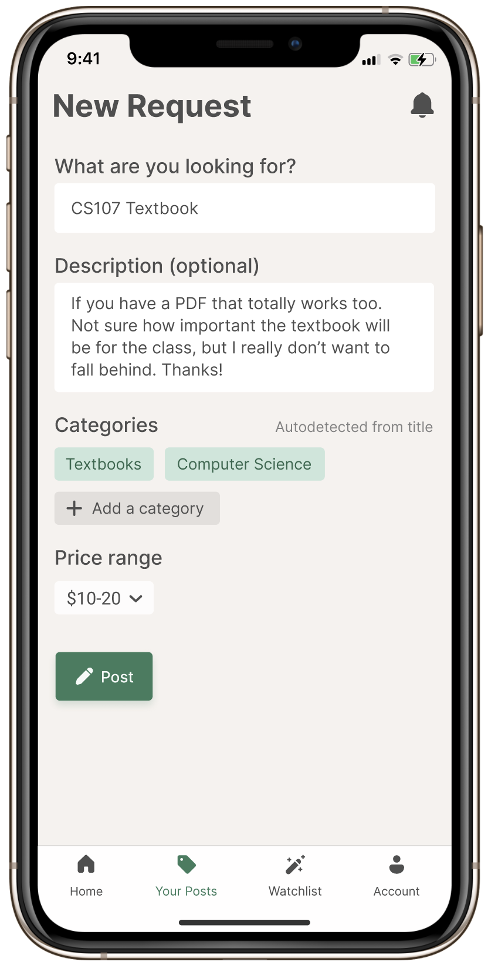
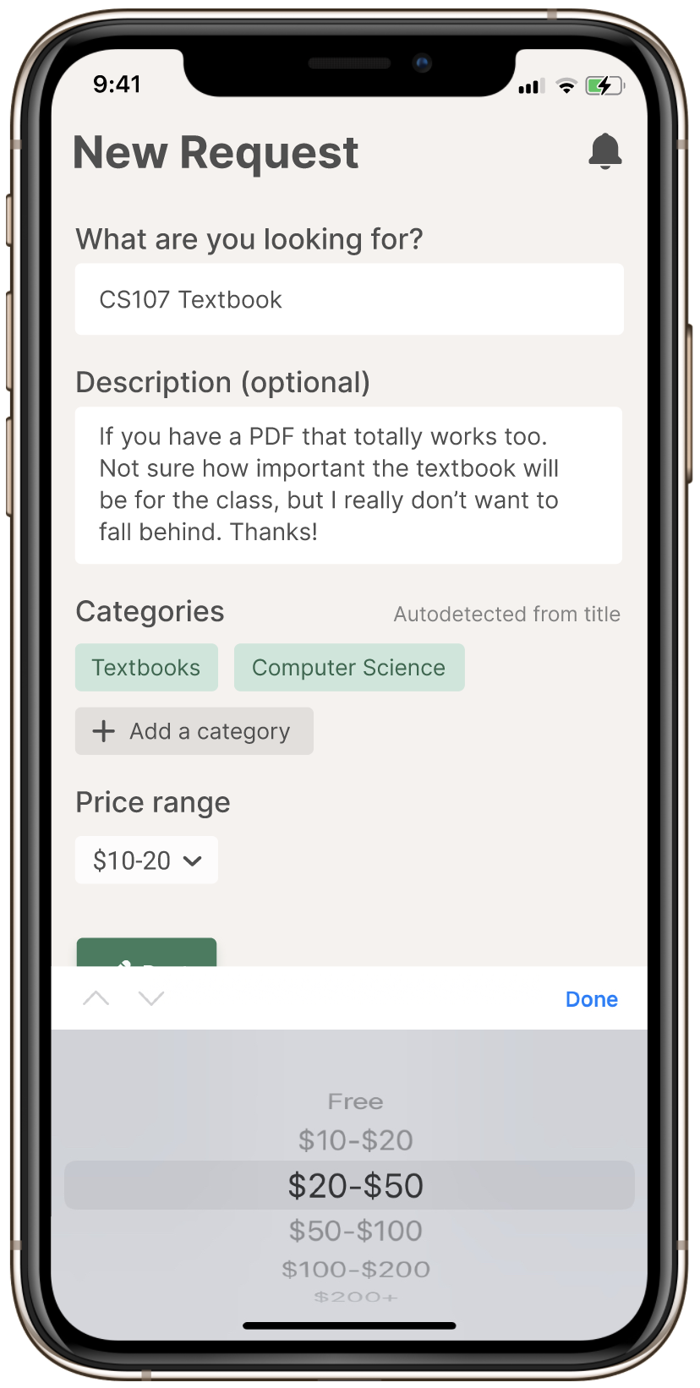

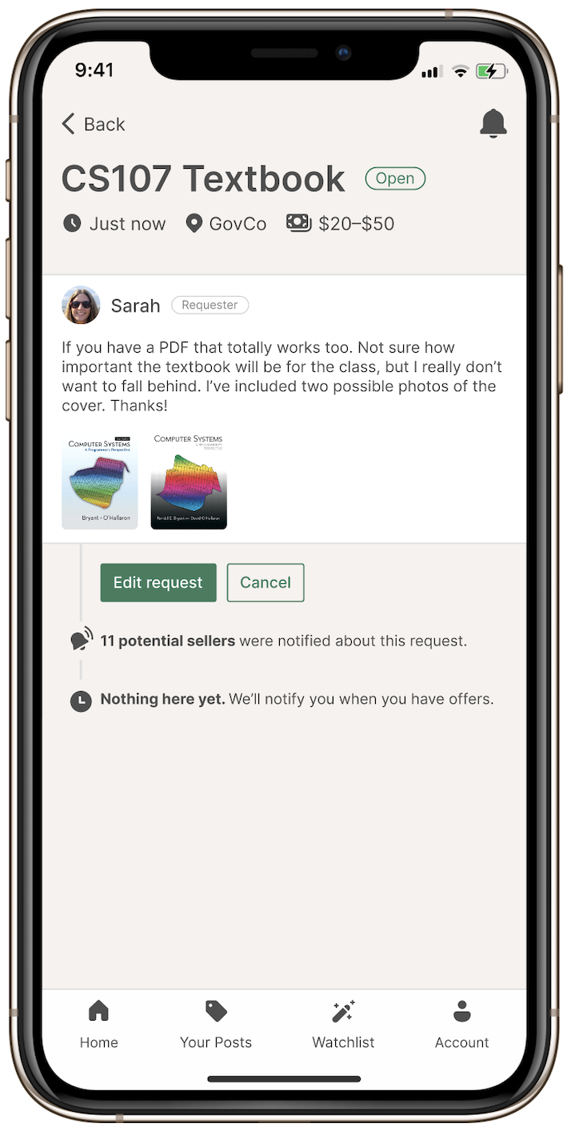
TASK 1: REQUEST AN ITEM, PART 2
* See speaker notes for more details
Notes:
Note:
Tapping the input elements will populate them with our hard-coded example inputs.
The category tags are not highlighted. The highlights have a border around them, which differentiates them from the category tags.

Slide 31
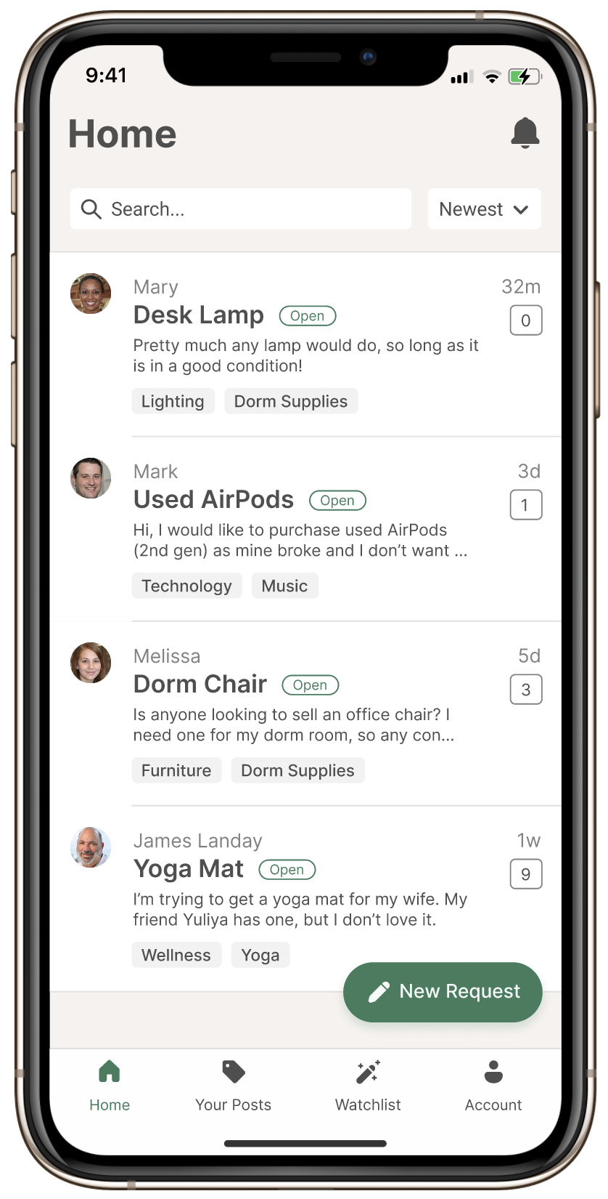
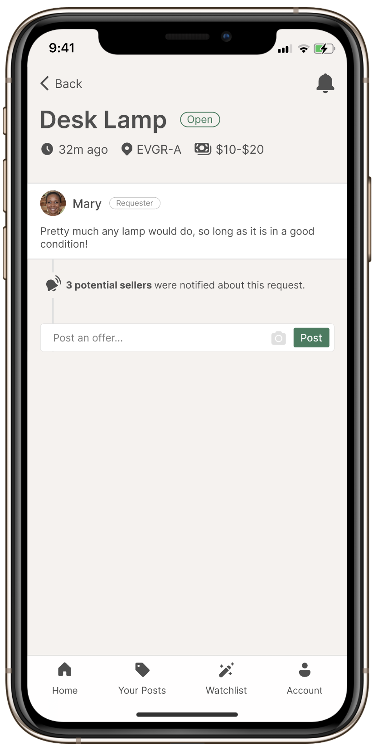
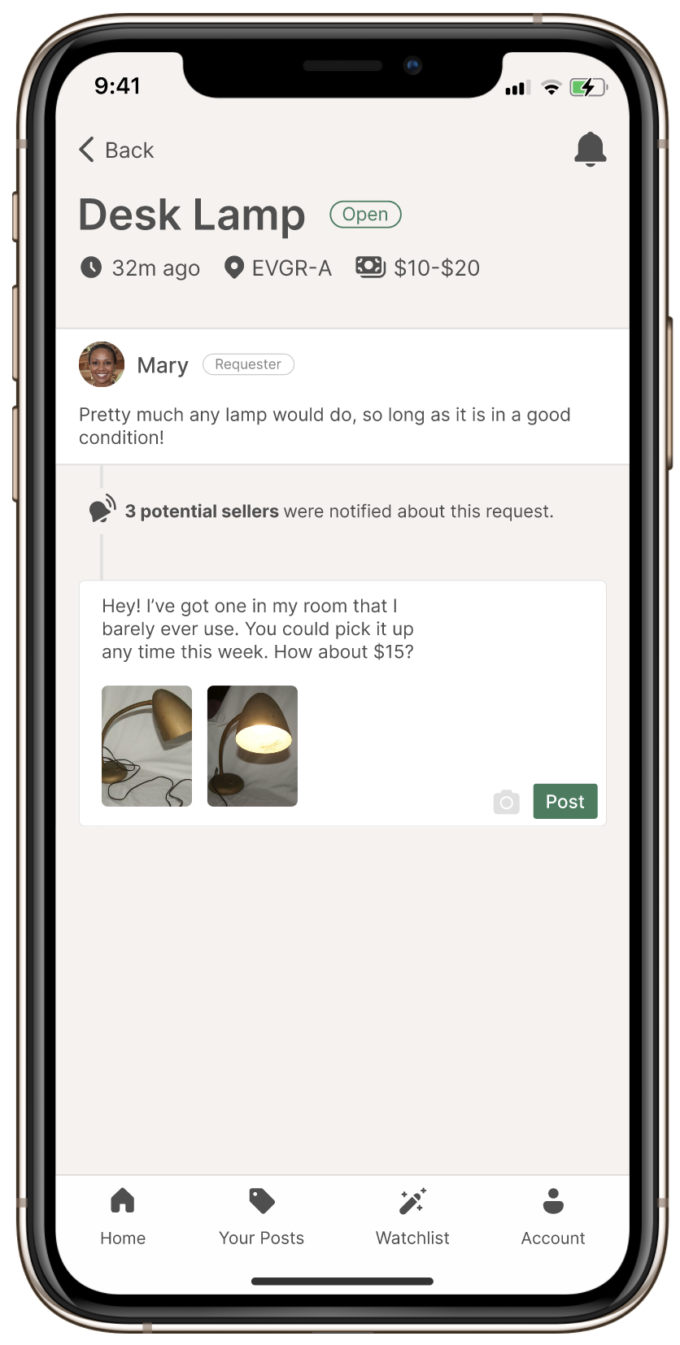
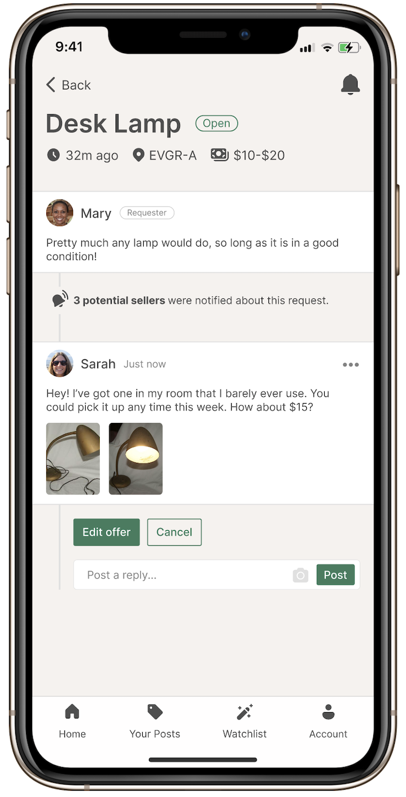
TASK 2: MAKE AN OFFER

Slide 32
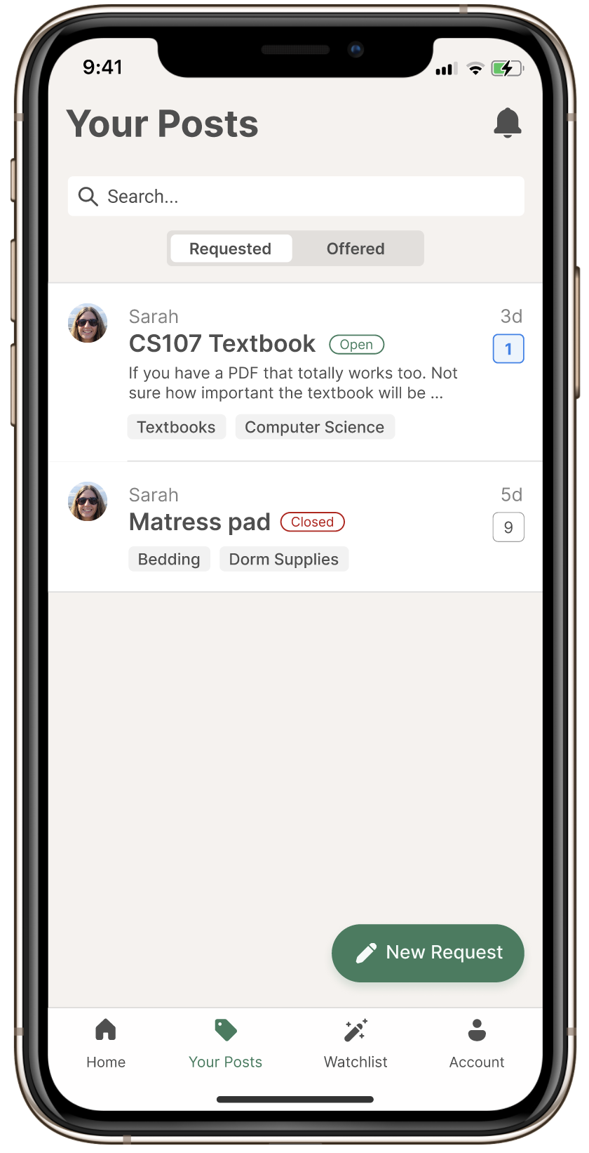
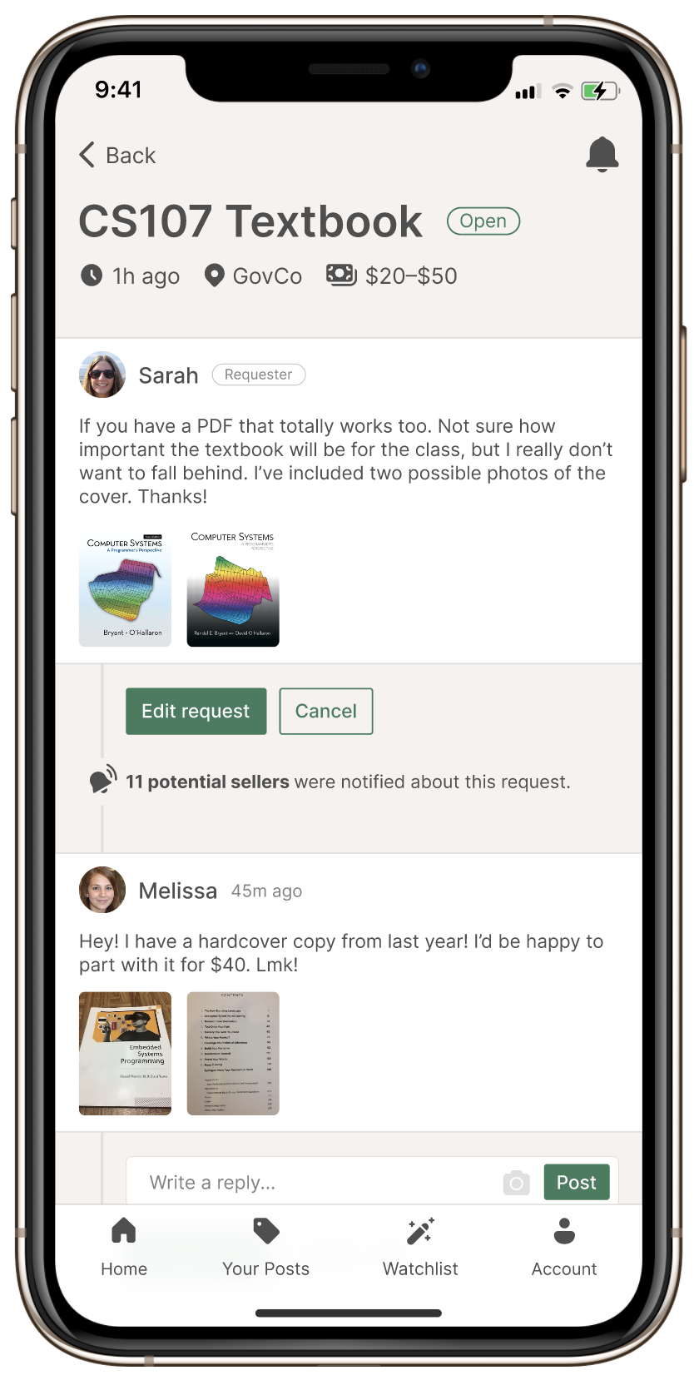
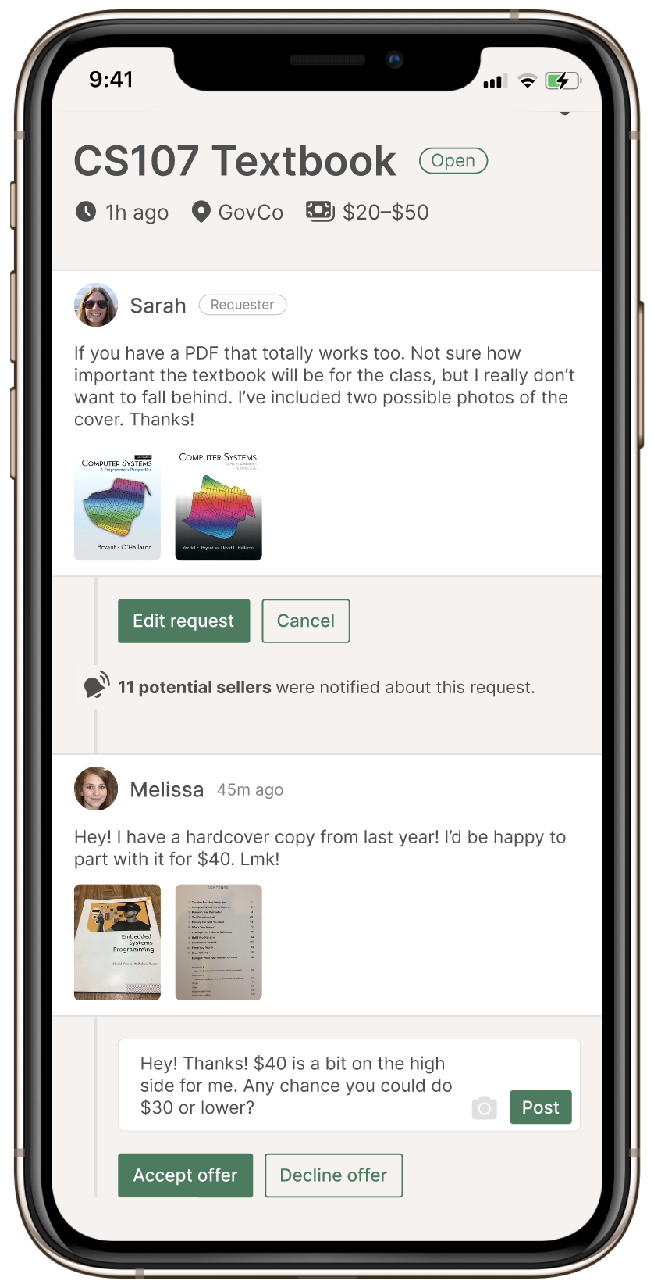
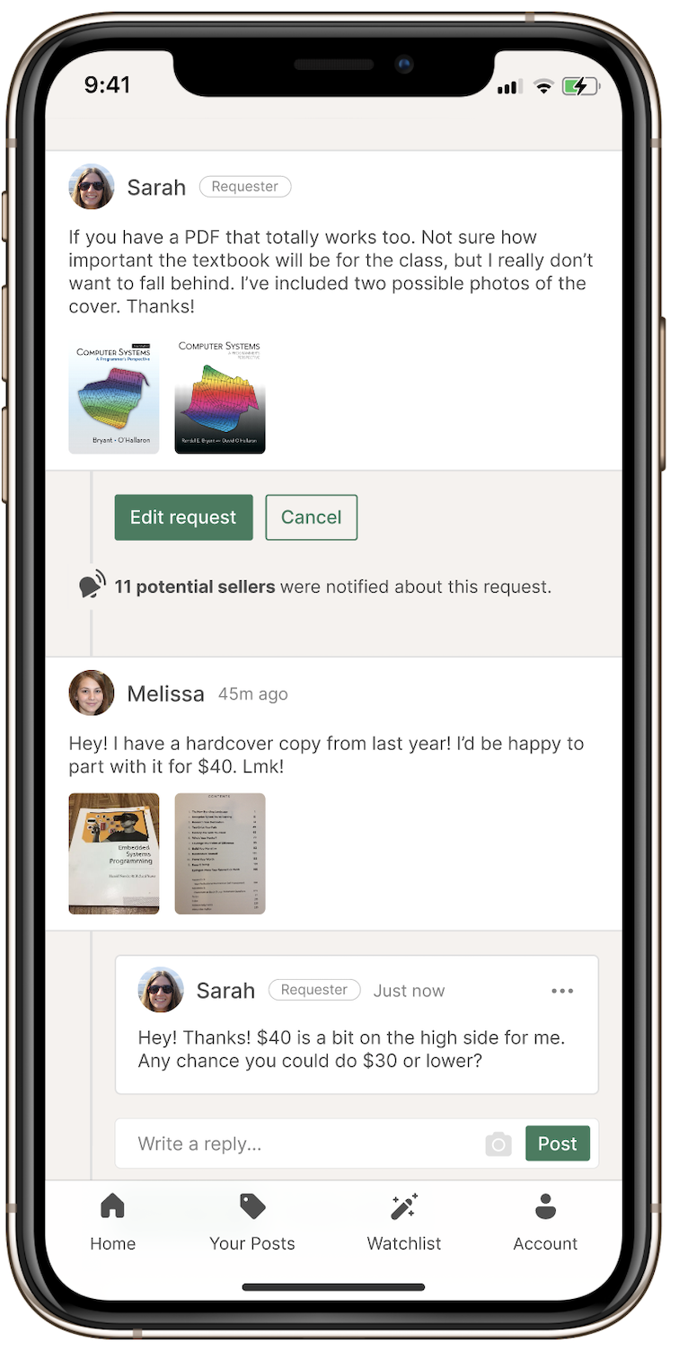
TASK 3: ACCEPT AN OFFER, PART 1
Two ways to reach offer
* See speaker notes for more details
Notes:
You can reach an offer by tapping on an offer-related notification or by viewing your request posts to check them for offers.

Slide 33
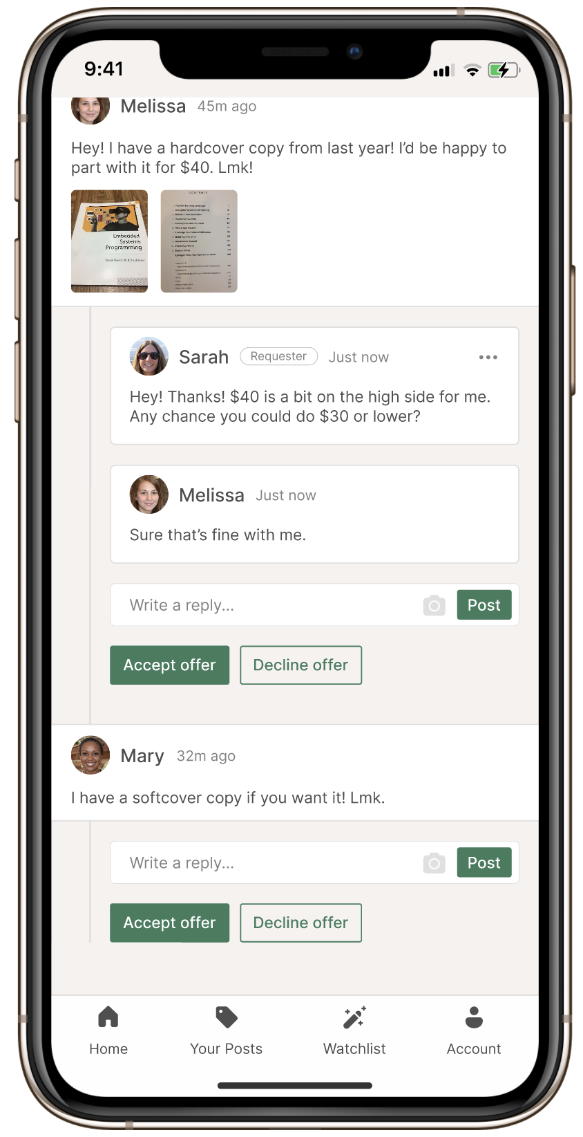
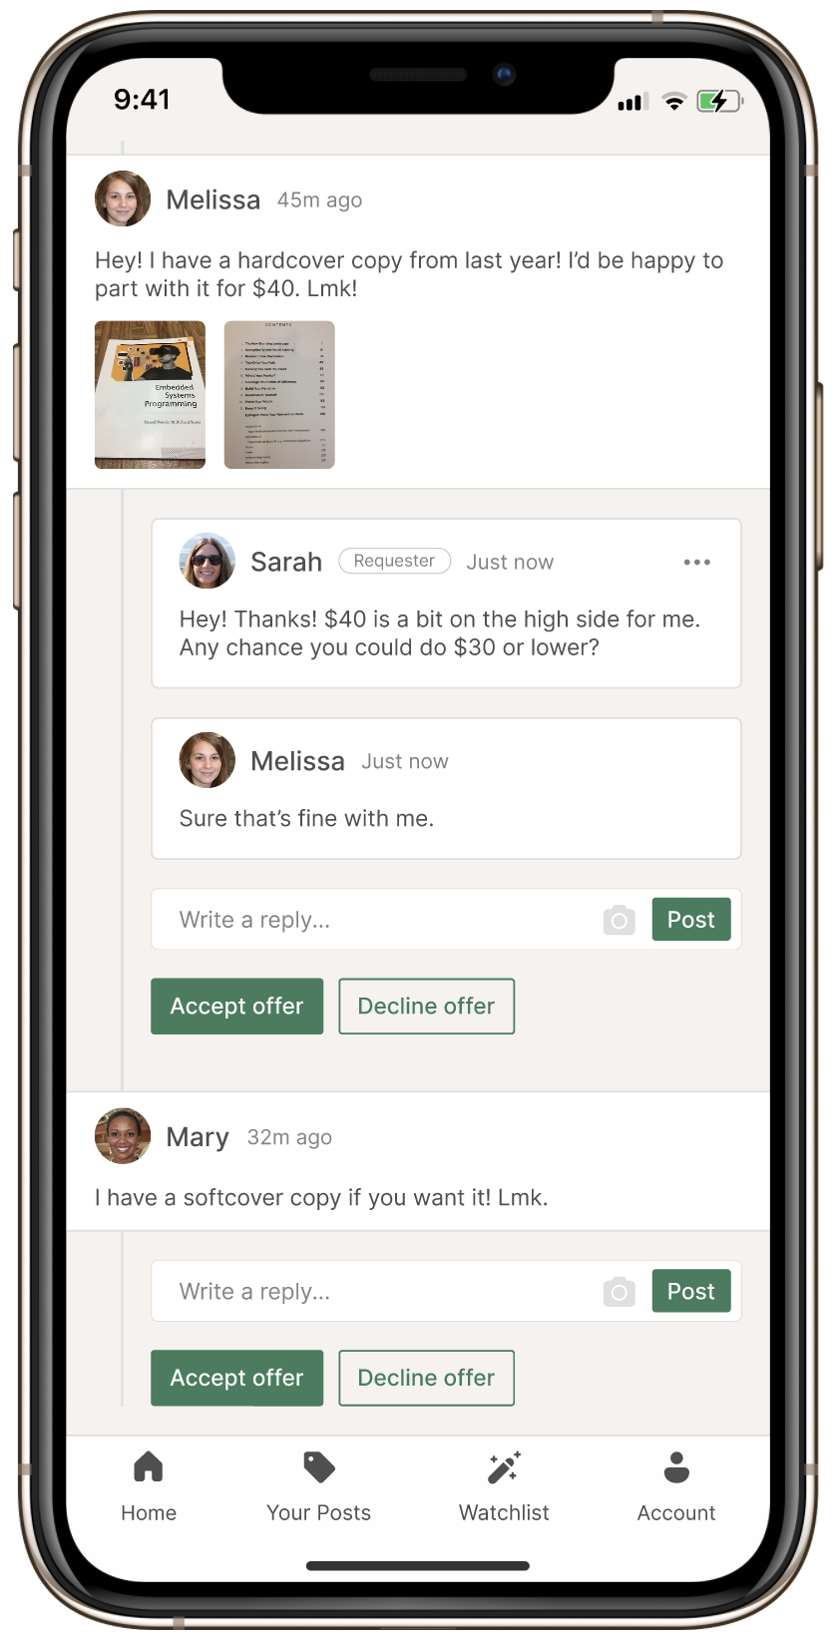
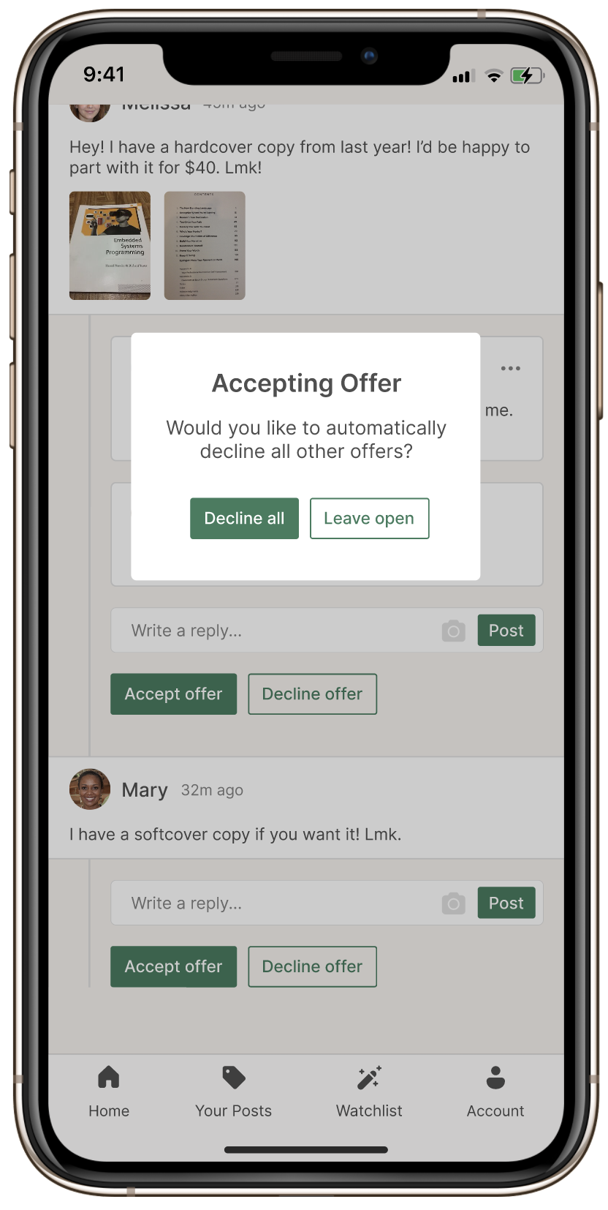
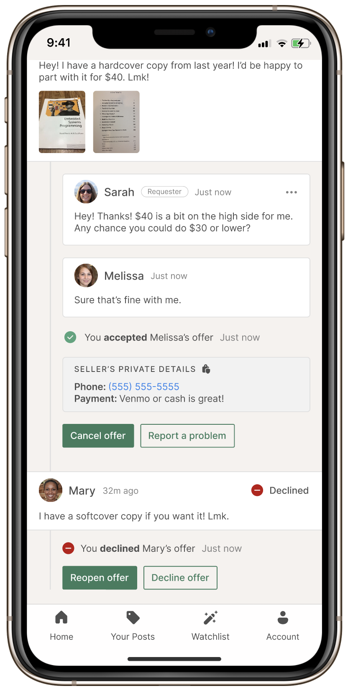
TASK 3: ACCEPT AN OFFER, PART 2
* See speaker notes for more details
Notes:
Note: Wizard of Oz responses, highlighted in blue, appear after a brief delay to mimic other users posting.

Slide 34




TASK 4: ADD AN ITEM TO WATCHLIST

Slide 35
Prototype Link
https://www.figma.com/proto/JEnVtlaCrdu9X5zuOdsBKz/Prototype
Notes:
As a buyer, finding someone in your community who’s selling what you need is hard—even if plenty of people would be willing to sell if asked. Reclaim is a reverse marketplace where buyers post what they need and anyone nearby can fulfill their request. Reclaim unlocks hidden supply for buyers and reduces the burden on sellers to manually list everything they’re willing to part with.

